Slide 1

Strategies for Helping First-Generation Students Succeed in the Classroom
Center for Teaching Excellence
East Tennessee State University
Dr. Michelle Hurley & Ms. Meagan Stark

Slide 2
Overview of Presentation
Who are first-generation (FG) students?
Barriers and challenges for FG students
Interventions to assist FG students
Discussion Questions
Notes:
MICHELLE

Slide 3

Notes:
MEAGAN: 10 minutes for activity. 5 minutes for discussion. Instructions: Complete this puzzle (as nearly complete as you can in the time allotted). Discussion: 1) The reveal – how many of you believe this to be a 2 D puzzle? 2) The idea of a thing – preconceived notions impact action and planning. Lack of resources – no one around you knows any more about it than you do. 3) Time constraints make it high stakes. There’s no room for mistakes – financial aide runs out. 4) How does this activity make you feel? (Empathy)

Slide 4
What does it mean to be first?
“Overcoming feelings of inadequacy and insecurity is one of the first and hardest obstacles that I have faced.”
“ I was in a foreign place where everyone seemed to have an advantage but me. I was lucky in that I had professors from similar backgrounds. If not for this, I would not be where I am today.”
“My first few years [of college] were filled with depression, stress and feelings of ‘I should have known this and why can I not grasp this class?’ Now as a senior who is graduating with honors, I feel relieved. However, I still feel underprepared at times”
“Do not underestimate me. I am trying my hardest. But don’t overestimate what I know because I might not know what you think is given knowledge for a college student.”
“Please understand the gaps in our knowledge. Allowing students to know that is okay not to know everything helps.”
“My experience as a [FG] student has been like a mouse navigating an academic maze where I am noticing that the other mice are more efficient than I am. I don’t understand what the difference is between us, which causes me self-doubt and anxiety.”
Getting my education is my priority but I can’t get my education unless I work. Please understand my struggle to balance my life.”
Notes:
MICHELLE

Slide 5
Who are our first-generation students?
Roughly 32% of students in the U.S. (Georgetown University Center on Education, 2012)
Disproportionately likely to be female, African-American, Hispanic, low-income, have dependent children. (Georgetown University Center on Education, 2012)
Enroll in and graduate from college at significantly lower rates than second & third generation peers. (Georgetown University Center on Education, 2012)
First-generation students graduate at a significantly lower rate (26% versus 68% w/in 8 years) even when demographics, motivation, preparation, academic progress, grade point average and income are accounted for. (Murphy & Hicks, 2006).
At ETSU approximately 35% (4000) of students are first-generation. (Office of Institutional Effectiveness, Fall 2017)
Notes:
MICHELLE

Slide 6
Barriers and University Challenges (Selby-Theut; Attewell, Heil & Reisel)
Academic Barriers
Financial Barriers
Report lower educational aspirations
More likely to enter college academically unprepared
Reading comprehension and critical thinking do not improve at as high a rate as peers
Earn lower GPA’s and take fewer hours
Avoid math, science and humanities majors
Have a less positive attitude about literacy (reading and writing activities)
Have trouble identifying major, finding internships or building their resume
Uninformed about financial aid – processes, etc.
More likely to have additional financial obligations
Have fewer resources to pay for college
Nature of and time allotted to work/study differ from that of second-generation peers
More likely to meet employment obligations than academic obligations
Notes:
MEAGAN

Slide 7
Barriers and University Challenges (Collier & Morgan; Selby-Theut; Lowery-Hart & Pacheco; Attewell, Heil, & Reisel)
Social Barriers
Cultural Barriers
More likely to live off campus
Less likely to participate in on-campus organizations/events
Identify their closest friends as someone other than college students
Report higher rates of isolation and discrimination – Can’t find their “place”
Perceive faculty as “distant” or unconcerned with them as individuals- intimidated
Less likely to identify college as necessary to achieving goals.
Parents lack “college knowledge”
Only 50% report that their parents are supportive of their decision to attend college
“Live simultaneously in two vastly different worlds while being fully accepted in neither.”
Often lack insight about WHY they are struggling
Worry that their experiences won’t be validated or appreciated
“Segregating” maintains the familiar familial identities and keeps them safe
Notes:
MEAGAN

Slide 8
FG Combined with Appalachian Culture (Collier & Morgan; Lowery-Hart & Pacheco; Hlinka, Mobelini & Giltner; Hlinka)
Factors that affect retention:
  A) Community’s & family’s values of education provide the initial PUSH to attend and complete college
    “Better paying jobs”
    “Less physical labor”
  B) Students are challenged with possessing the cultural capital that enables them to overcome the PULL of family obligations
    “Sticking together”
    Cannot always tell when academics trump family
    “College student” versus own identity tied to family – “Phony”. Honoring own culture by rejecting college culture. Divided consciouseness.
  C) Students struggle to collect the academic capital to master college-level coursework
    The transition from concrete (memorization) to abstract orders of cognitive development
Notes:
MEAGAN
Working class and clannish
Appalachian culture can exaggerate FG obstacles
Appalachian culture emphasizes family involvement and loyalty
Underperforming high schools
Appalachian students can self-limit because they want to stay in the area so it affects their viewpoint of what is possible.

Slide 9

Seven Principles for Good Practice in Undergraduate Education (Padgett, Johnson & Pascaralla)
1) Encouraging contact between student and faculty * Paradox for FG students
2) Encouraging cooperation among students ** Very helpful
3) Encourage active learning
4) Provide prompt feedback
5) Emphasize time on task
6) Communicate high expectations
7) Respect diverse talents and ways of learning
Notes:
MEAGAN AND MICHELLE
Best practices for all students may need tweaking for FG students.

Slide 10
1) Encouraging Contact Between Faculty and Student
Explain office hours
Work on being approachable
Model courtesy
Initiate contact/offer incentives for contact
Humanize
Identify as FG if that applies
Limit academic jargon
Make a concerted effort to learn something personal about the student
Engage with students outside the classroom – sports events, conferences, etc.
Notes:
MEAGAN
Students tend to think of interactions with faculty in terms of relationship building while faculty see it in terms of problem-solving. Both agree it is the student’s responsibility to initiate but with FG students, it may be best for the faculty to make the first move.

Slide 11

2) Encouraging Cooperation Among Students
Encourage participation in tutoring. (“I was taught to do it on my own and not take help”). Assistance v. Resistance
Develop and facilitate group study
Pair FG student with a continuing student (discretely)
Develop low-stakes group work/assignments
“Shrink the campus” into a more manageable community
Monitor language that is used in the classroom so that “in-groups” and “out-groups” are not created in terms of prior academic experiences.
Incorporate self-assessment and peer review
Notes:
MICHELLE

Slide 12

A Fish In Water
Vincent Tinto’s (1975) Integration Theory:
“Students must first feel socially integrated, as though they belong or fit in the college setting, before being able to focus on academic integration…”
Notes:
MICHELLE

Slide 13
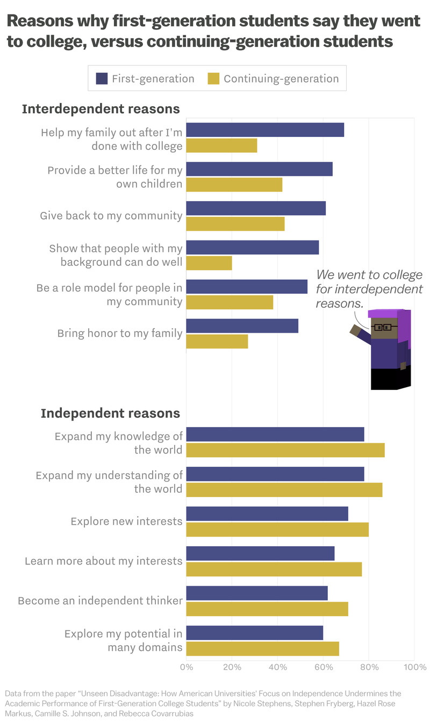
3) Encourage Active Learning
Design assignments that emphasize practical application
Teach from a learning outcomes framework – what students will know, will be able to do
Tap into students’ prior experiences and help them learn how to apply it to new content
Help students understand how your class fits into their major/minor and into their professional preparation
Notes:
MEAGAN : Working class students are not necessarily in college for the traditional college experience – they are here to learn a trade, make money, and get a job.

Slide 14
4) Provide Prompt Feedback
Provide examples of strong and weak work
Offer constructive feedback so that formative evaluation can take place. Don’t forget to highlight student strengths.
Help students understand what it means to evaluate and critique ideas. Some FG students may come from backgrounds that punish vulnerabilities and views criticism as a personal attack. Some FG students may not be familiar with the academic process that is part of college culture. Normalize the process.
Help students to identify resources where they can receive help.
Offer incentives for help-seeking behaviors
Notes:
MICHELLE

Slide 15
5) Emphasize Time on Task
Students feel that the time they have available for schoolwork should determine priorities (rather than what amount of time it would actually take to master the material). School should “fit” with other responsibilities not necessarily be the priority.
FG students tend to overcommit but have fewer resources.
Help students learn the “balance” between home and school. Time management skills should be emphasized. Proactive advising is helpful.
“Helping” family alleviates some of the family achievement guilt felt by many FG students
Notes:
MEAGAN

Slide 16
6) Communicate High Expectations
Communicate high expectations in a supportive way
Be intentional. Explain your teaching approach and instructional strategies.
Provide guidelines and rubrics on how students will be evaluated. Use a detailed syllabus with bullet points and bold font to emphasize important points. Be specific about how to take notes. Faculty think that they already do this. Don’t just hand out – go over.
Understanding the implied meaning is not always a given. “Write” the paper for example. Be explicit. Check assignments for clarity. Style guides.
FG students want faculty to be more explicit on how to take notes, assignment descriptions and specifics about tests. FG students tend to rely almost exclusively on information that they hear and observe in class from the professor.
Notes:
MICHELLE
Students want bold, bulleted items to emphasize what is important. Perhaps using a different colored paper for the syllabus.

Slide 17
7) Respect Diverse Talents and Ways of Learning
Bringing FG cultural wealth into classroom.
Use intergroup dialogue (supportive, safe and identity-safe) to explore how significant social differences – such as race, ethnicity, gender, social class, etc. can shape their own and others’ experiences and opportunities in college and life.
Have a conversation about what it means to be a “good” son or daughter and a good student at the same time- can’t always be “do what you’re told” - Storytelling about success is a powerful tool – “My aunt’s boyfriend’s sister’s dog had to be put down.”
Notes:
MEAGAN Students’ participation in these dialogues increased empathy and understanding, collaboration and civic engagement.
Help students understand how their different backgrounds matter, has the potential to increase student comfort and ability to operate in diverse settings.
Students’ backgrounds can shape the college experience in both positive and negative ways and students should take their backgrounds into consideration when strategizing for success.

Slide 18
Diverse Talents Cont.
Help students feel valued and cared for (mimicking the familial experience to some extent). Coddling versus cutting the apron strings – finding the balance.
Highlighting and reframing deficits as strengths.
Build bridges between their home and validate their presence at the academy. ( Educate students and families on the realities of earning an education and setting priorities)
Familiarize students with what resources are available.
Notes:
MICHELLE

Slide 19
TRIO RESOURCES AT ETSU
Student Support Services
McNair Program
Tutoring
Graduate School Counseling
Career Counseling
Personal Counseling
WILL BE LOCATED IN LUCILLE CLEMENT DURING CULP RENO
Undergraduate retention
Research skill development
Graduate school preparation
Faculty mentors
LOCATED IN THE CAMPUS CENTER BUILDING
Notes:
MEAGAN and MICHELLE

Slide 20
Discussion Questions
How can you be flexible in the classroom and still maintain some sense of structure?
How do you find the time to do all this while still teaching your content?
Notes:
MEAGAN and MICHELLE

Slide 21
References
Billson, J., & Brooks, T. (1981). In search of the silken purse: Factors in attrition among first-generation students. Presented to the Annual Meeting of the Association of American Colleges. Denver, CO.
Engle, J, Bermeo, A., & O’Brien, C. (2006). Straight from the source: what works for first-generation college students. Pell Institute for the Study of Opportunity in Higher Education. Washington, DC.
Hlinka, K.R. (2017). Tailoring retention theories to meet the needs of rural Appalachian community college students. Community College Review, 45 (2), 144-164.
Murphy, C., & Hicks, T. (2006). Academic characteristics among first-generation and non-first generation college students. College Quarterly, 9.
Terenzini, P., Springer, L., Yaeger, P., Pascarella, E., & Nora, A. (1995). First-generation college students: Characteristics, experiences, and cognitive development. Association for Institutional Research. Boston, MA.
First-Generation Students in Postsecondary Education: A Look at Their College Transcripts. (2005). National Center for Education Statistics Descriptive Analysis Report.

Slide 22
References cont.
Stephens, N.M., Hamedani, M.G., Destin, M. (2014). Closing the social-class achievement gap: A difference – education intervention improves first-generation students’ academic performance and all students’ college transition. Psychological Science, 25, (4), 943-953.
Padgett, R.D., Johnson, M.P., Pascarella, E.T. (2012). First-generation undergraduate students and impact of the first year of college: Additional evidence. Journal of College Student Development, 53 (2), 243-266.
Promoting instructional success for first-generation college students (n.d.). Center for Educational Effectiveness , UC Davis.
Lohman, L. (2015). Twenty-two tips for teaching first-generation college students at CSUF.
Collier, P.J. & Morgan, D.L. (2008). Is that paper really due today? : Differences in first-generation and traditional college students’ understanding of faculty expectations. Higher Education 55, 425-446.
Lowery-Hart, R. & Pacheco, G. (2011). Understanding the first-generation student experience in higher education through a relational dialectic perspective. New Directions for Teaching and Learning, 127, (55-68).
Selby-Theut, M. (n.d.). The first generation student: Barriers and strategies for success. Retrieved 1/23/2018.

Slide 23
References cont.
Attewell, P., Heil, S. & Reisel, L. (2011). Competing explanations of undergraduate noncompletion. American Educational Research Journal, 48 (3), 536-559.
Hlinka, K.R., Mobelini, D.C. & Giltner, T. (2015). Tensions impacting student success in a rural community college. Journal of Research in Rural Education, 30 (5), 1-16.
Stephens, N.M., Fryberg, S. A., Markus, H.R., Johnson, C.S. & Covarrubias, R. (2012). Unseen disadvantage: How American universities’ focus on independence undermines the academic performance of first-generation college students. Journal of Personality and Social Psychology, 102 (6), 1178-1197.
Phillips, L. T., Stephens, N.M. & Townsend, S.S.M. (2016). Access is not enough: Cultural mismatch persists to limit first-generation students’ opportunities for achievement through college. [Scholarly project]. J.L. Kellogg School of Management at Northwestern University. Retrieved 03/30/2018.
Tinto, V. (1975). Dropout from higher education: A theoretical synthesis of recent research. Review of Educational Research 45, (1), 89-125.

