Slide 1
DESIGNING COURSES for SIGNIFICANT LEARNING
Workshop led by:
L. Dee Fink, Ph.D.
Educational Consultant in Higher Education
Author: Creating Significant Learning Experiences
East Tennessee State University
January 8, 2018
Notes:
This worked well for a 1.5 hr presentation.

Slide 3
SPECIFIC GOALS for This Workshop
FOUNDATIONAL KNOWLEDGE: Understand the basic terms and concepts
APPLICATION: Be able to use the model of Integrated Course Design (ICD)
INTEGRATION: Identify the relationship between what you are doing now as a teacher and the ideas of ICD (continued)

Slide 4
SPECIFIC GOALS for This Workshop (cont.)
HUMAN DIMENSION:
  SELF: Be more confident that you can do this
  OTHERS: Work with others to create more powerful designs
CARING: Identify the value of course design in teaching
LEARNING HOW TO LEARN: Know what else you want to learn about course design – and how to learn that.

Slide 6
Readiness Assessment Test
(RAT)

Slide 7
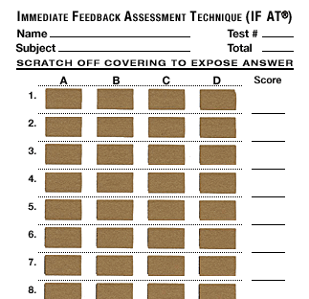
Readiness Assessment Test
www.epsteineducation.com

Slide 8


Slide 9
# of SCRATCHES: # of POINTS:
1 - - - - 4
2 - - - - 2
3 - - - - 1
4 - - - - 0

Slide 10
Integrated Course Design:
SITUATIONAL FACTORS

Slide 11
Criteria of “GOOD” Course Design
Significant
Learning
Learning Outcomes
Integration
Teaching and
Learning
Activities
Feedback &
Assessment
Active
Learning
Educative
Assessment
S I T U A T I O N A L F A C T O R S
In-Depth Situational Analysis

Slide 12
Situational Factors:
Collecting information about…
  Specific Context
  Expectations by people outside the course
  Nature of the Subject
  Nature of Students
  Nature of Teacher

Slide 13
Situational Factors
Specific Context of the Teaching/Learning Situation
  Number of students
  Level of course
  Time structure
  Delivery: Live – Hybrid – Online
Expectations of Others:
  What expectations are placed on this course or curriculum by:
    Society?
    The University, College and/or the Department?
    The Profession?

Slide 14
Nature of the Subject
  Primarily theoretical, practical, or some combination?
  Convergent or divergent?
  Important changes or controversies occurring?
Characteristics of the Learners
  Their life situation (e.g., working, family, professional goals)?
  Their prior knowledge, experiences, and initial feelings?
  Their learning goals, expectations, and preferred learning styles?

Slide 15
Characteristics of the Teacher(s)
  My beliefs and values about teaching and learning?
  My attitude toward: the subject, students?
  My teaching skills?
  My level of knowledge or familiarity with this subject?

Slide 16
Criteria of “GOOD” Course Design
Significant
Learning
Learning Outcomes
Integration
Teaching and
Learning
Activities
Feedback &
Assessment
Active
Learning
Educative
Assessment
S I T U A T I O N A L F A C T O R S
In-Depth Situational Analysis

Slide 17
Integrated Course Design:
DESIRED LEARNING OUTCOMES

Slide 18
Criteria of “GOOD” Course Design
Significant
Learning
Learning Outcomes
Integration
Teaching and
Learning
Activities
Feedback &
Assessment
Active
Learning
Educative
Assessment
S I T U A T I O N A L F A C T O R S
In-Depth Situational Analysis

Slide 19
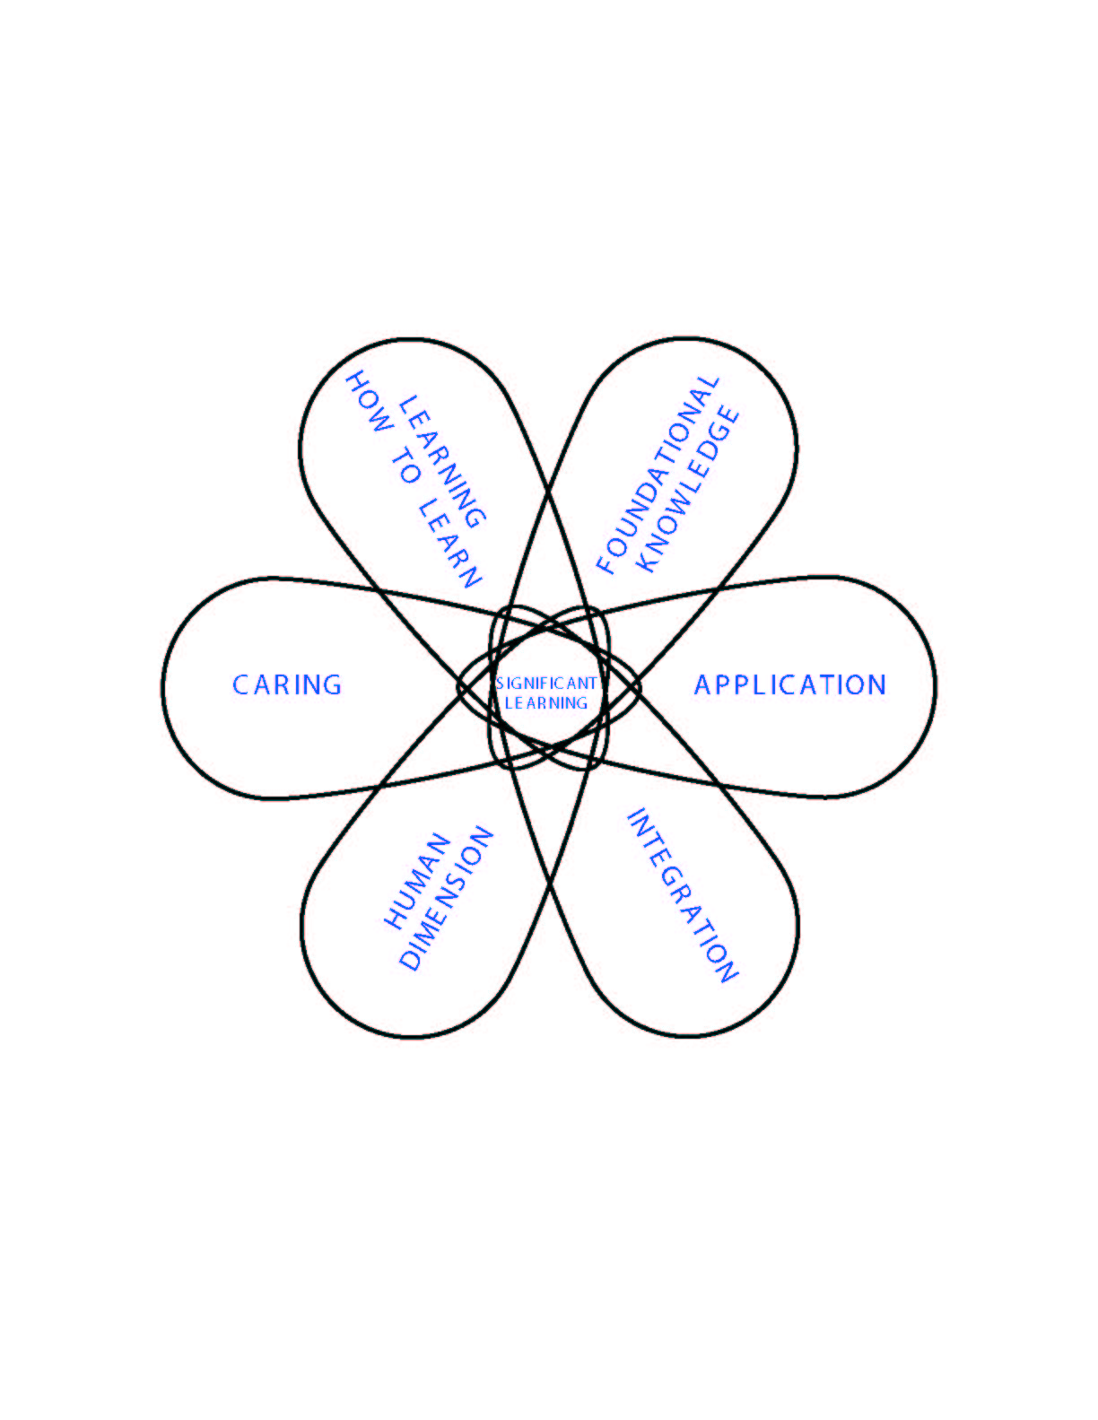
Taxonomy of Significant Learning

Slide 20
Taxonomy of Significant Learning
Learning How to Learn
Becoming a better student
Inquiring about a subject
Self-directing learners
Foundational Knowledge
Understanding and
remembering:
  Information
  Ideas
Application
Skills
Thinking: Critical, Creative, & Practical
Managing projects
Caring
Developing new…
  Feelings
  Interests
  Values
Integration
Connecting:
  Ideas
  People
  Realms of life
Human Dimensions
Learning about:
  Oneself
  Others

Slide 21
In a course with significant learning, students will:
Understand and remember the key concepts, terms, relationship, etc.
Know how to use the content.
Be able to relate this subject to other subjects.
Understand the personal and social implications of knowing about this subject.
Value this subject and further learning about it.
Know how to keep on learning about this subject, after the course is over.

Slide 22
Can you CLASSIFY these Learning Outcomes?
“By the end of the course, students will be able to…
Demonstrate increased confidence in using ICD to redesign their own courses.
Identify the six parts of the taxonomy of significant learning when looking at examples of outcomes.

Slide 23
Can you CLASSIFY these Learning Outcomes?
“By the end of the course, students will be able to…
Find increased value in the importance of course design in higher education.
Use some of the information learned in the course when given a specific hospitality situation.

Slide 24
Rate the QUALITY of these Learning Outcomes:
Learn the basic theories of Social Psychology.
Write an analysis of a major historical event, using historical information and reasoning in an appropriate manner.
Communicate in Spanish with grammatically correct sentences.

Slide 25
3-COLUMN TABLE:
Learning Outcomes: Assessment Activities: Learning Activities:
1. Found. Know.
2. Application
3. Integration
4. Human Dim.: Self, Others
5. Caring
6. Learning How to Learn

Slide 26
Individual Assignment:
Write one Learning Outcome for one of your courses:
  From the Taxonomy, on: “INTEGRATION”
Preface: “My hope is that, by the end of the course, students will be able to….”
Suggestions:
  Pay close attention to your VERBS
  Strive for “High Visibility” for students

Slide 27
Criteria of “GOOD” Course Design
Significant
Learning
Learning Outcomes
Integration
Teaching and
Learning
Activities
Feedback &
Assessment
Active
Learning
Educative
Assessment
S I T U A T I O N A L F A C T O R S
In-Depth Situational Analysis

Slide 28
Integrated Course Design:
FEEDBACK &
ASSESSMENT

Slide 29
Criteria of “GOOD” Course Design
Significant
Learning
Learning Outcomes
Integration
Teaching and
Learning
Activities
Feedback &
Assessment
Active
Learning
Educative
Assessment
S I T U A T I O N A L F A C T O R S
In-Depth Situational Analysis

Slide 30
ASSESSMENT Activities: 2 Steps
Identify assessment activities appropriate to each of your learning goals, using the 3-column table.
Use principles of Educative Assessment to develop powerful assessment activities

Slide 31
ASSESSMENT ACTIVITIES: 2 Steps
Identify assessment activities appropriate to each of your learning goals, using the 3-column table.
Use principles of Educative Assessment to develop powerful assessment activities

Slide 32
3-COLUMN TABLE:
Learning Outcomes: Assessment Activities: Learning Activities:
1. Found. Know.
2. Application
3. Integration
4. Human Dim. Self, Others
5. Caring
6. Learning How to Learn

Slide 33
3-COLUMN TABLE:
Learning Outcomes: Assessment Activities: Learning Activities:
1. Found. Know. | Multiple-choice tests
2. Application | Case studies
3. Integration | Essays, focused on Integration
4. Human Dim. Self, Others | Reflective essays
5. Caring | Statements of preferences
6. Learning How to Learn | Learning portfolios

Slide 34
“Feedback & Assessment”
FIRST ASSIGNMENT
IDENTIFY appropriate assessment activities for your “Integration” Learning Goal, using the 3-column table.
Important Principle:
  Different Assessment Activities for Different Learning Goals (see handout)

Slide 35
ASSESSMENT ACTIVITIES:
Identify assessment activities appropriate to each of your 2 learning goals, using the 3-column table.
2nd Task:
Check your assessment activities, using the principles of Educative Assessment

Slide 36
Feedback and Assessment:
“EDUCATIVE ASSESSMENT”
Important Learning
Forward-Looking Assessment Task
Criteria and Standards
Self-Assessment
Feedback

Slide 37
“FIDeLity Feedback”
F = Frequent
I = Immediate
D = Discriminating (based on
criteria and standards)
L = Feedback given in a
Loving or supportive way

Slide 38
Integrated Course Design:
LEARNING ACTIVITIES

Slide 39
Criteria of “GOOD” Course Design
Significant
Learning
Learning Outcomes
Integration
Teaching and
Learning
Activities
Feedback &
Assessment
Active
Learning
Educative
Assessment
S I T U A T I O N A L F A C T O R S
In-Depth Situational Analysis

Slide 40
LEARNING ACTIVITIES:
Identify learning activities that are appropriate to each of your learning goals, using the 3-column table.
For powerful learning activities, use the principles of Active Learning.

Slide 41
3-COLUMN TABLE:
Learning Outcomes: Assessment Activities: Learning Activities:
1. Found. Know.
2. Application
3. Integration
4. Human Dim.: Self, Others
5. Caring
6. Learning How to Learn

Slide 42
3-COLUMN TABLE:
Learning Outcomes: Assessment Activities: Learning Activities:
1. Found. Know. |  | Reading
2. Application |  | In-class problem solving, with fdbk.
3. Integration |  | Discussion (small group?)
4. Human Dim.: Self, Others |  | Reflections, essays
5. Caring |  | Community projects
6. Learning How to Learn |  | Project: learn something new

Slide 43
ASSIGNMENT:
In the 3-column table, IDENTIFY one or two learning activities for your “Integration” learning goal.

Slide 44
LEARNING ACTIVITIES:
Identify learning activities that are appropriate to each of your learning goals, using the 3-column table.
For powerful learning activities, use the principles of Active Learning.

Slide 45
A MODEL OF ACTIVE LEARNING
(The Basic Version)

Slide 46
Holistic Active Learning
Experience
  Doing, Observing
  Actual, Simulated
  “Rich Learning Experiences”
Reflection
  About the…
    Subject
    Learning Process
  Via: Journaling, Learning Portfolios
Information & Ideas
  Primary/Secondary
  In-class, out-of-class, online

Slide 47
Multiple Activities that Promote
ACTIVE LEARNING
GETTING
EXPERIENCE
REFLECTIVE DIALOGUE,
INFORMATION
with:
& IDEAS
"Doing"
"Observing"
Self
Others
•
Original
•
Real
•
Direct
•
Reflective
•
Live
data
Doing, in
observation
thinking
dialogue
DIRECT
authentic
of
•
Original
settings
phenomena
•
Journaling
(in or out
sources
of class)
•
Secondary
•
Case
•
Stories
data and
studies
(can be
INDIRECT,
sources
•
Gaming,
accessed
VICARIOUS
•
Lectures,
Simulations
via: film,
•
Role play
literature,
textbooks
oral history)
•
Course
•
Teacher can assign
students
•
Students can reflect,
website
to "directly experience" …
and then engage in
ONLINE
various kinds of
•
Internet
•
Students can engage in
dialogue online.
"indirect" kinds of experience
online

Slide 48
HOLISTIC ACTIVE LEARNING:
A Case Study
In a course on “Leadership for Engineers,” the teacher does the following:
Begins the course by asking students to think about what leadership means to them, individually and then collectively.
Then the class reads a book or case study about people in leadership positions (e.g., Abraham Lincoln).
Following this, they re-visit the central question of “What constitutes leadership”? and revise their earlier definition accordingly.
This sequence is repeated throughout the course:
  students read something – revisit the central question
  – read something new – revisit the central question
  – etc.

Slide 49
Question #1:
Which of the three components of holistic active learning does this course include – as described above? (More than one component is possible)
    1. Information and Ideas
    2. Experience
    3. Reflection
Question #2:
How might you strengthen the “Experiential” component?

Slide 50
Criteria of “GOOD” Course Design
Significant
Learning
Learning Outcomes
Integration
Teaching and
Learning
Activities
Feedback &
Assessment
Active
Learning
Educative
Assessment
S I T U A T I O N A L F A C T O R S
In-Depth Situational Analysis
Notes:
50

Slide 51
Integrated Course Design:
INTEGRATION

Slide 52
Criteria of “GOOD” Course Design
Significant
Learning
Learning Outcomes
Integration
Teaching and
Learning
Activities
Feedback &
Assessment
Active
Learning
Educative
Assessment
S I T U A T I O N A L F A C T O R S
In-Depth Situational Analysis

Slide 53
INTEGRATING THE COURSE
Primary Tool: WEEKLY SCHEDULE
      Teaching Strategy
      Culminating Project
      String of Activities

Slide 54
3-COLUMN TABLE:
Learning Goals: Assessment Activities: Learning Activities:
1.
2.
3.
4.
5.
6.

Slide 55
WEEKLY SCHEDULE
Week #: Mon Wed Fri
1
2
3
4
..
..
12
13
14
15
?
?
?

Slide 56
Set of Learning Activities
D
Set of Learning Activities
C
Set of Learning Activities
B
Set of Learning Activities
A
T I M E

Slide 57
Building Your Weekly Schedule:
  See handout

Slide 58
Building Your Weekly Schedule (F2F)
Topics/Themes/Major Questions | Development of “Doing” Projects | Parallel, Individual Activities
Foundational Knowledge (mostly) | Application, Integration, Human Dimension/Other | Caring, Hum. Dim./ Self, Learning How to Learn

Slide 59
Building Your Weekly Schedule (F2F)
Topics/Themes/Major Questions | Development of “Doing” Projects | Parallel, Individual Activities
Foundational Knowledge (mostly) | Application, Integration, Human Dimension/Other | Caring, Hum. Dim./ Self, Learning How to Learn
 | Inside Class
You Implement It:
Step “A”
Step “B”
Step “C”
Culm.
Project
You Plan It:

Slide 60
Building Your Weekly Schedule (F2F)
Topics/Themes/Major Questions | Development of “Doing” Projects | Parallel, Individual Activities
Foundational Knowledge (mostly) | Application, Integration, Human Dimension/Other | Caring, Hum. Dim./ Self, Learning How to Learn
Topic “A” Topic “B” Topic “C” Topic “D” Et cetera
Read: Outside of Class Test: Inside | Inside Class
Step “A”
Step “B”
Step “C”
Culm.
Project

Slide 61
Building Your Weekly Schedule (F2F)
Topics/Themes/Major Questions | Development of “Doing” Projects | Parallel, Individual Activities
Foundational Knowledge (mostly) | Application, Integration, Human Dimension/Other | Caring, Hum. Dim./ Self, Learning How to Learn
Topic “A” Topic “B” Topic “C” Topic “D” Et cetera |  | Example: “String of Activities” X Y Z Culminating Report
Read: Outside of Class Test: Inside | Inside Class | “Doing”: Inside & Outside of Class Refl. Writing: Outside of Class
Step “A”
Step “B”
Step “C”
Culm.
Project

Slide 62
INTEGRATING THE COURSE
  Weekly Schedule:
      TEACHING STRATEGY
      Culminating Project
      String of Activities

Slide 63
TEACHING STRATEGY:
  A particular COMBINATION of learning activities…
  arranged in a particular SEQUENCE
Two Examples:
  Problem-based learning
  Team-based learning

Slide 64
“CASTLE-TOP” DIAGRAM:
A Tool for Identifying Your
TEACHING STRATEGY
Mon Wed Fri Mon Wed Fri
In-Class Activities: | ? |  | ? |  |  |  |  |  |  |  | Assessm’t & Feedback
Out-of-Class Activities: |  | ? |  | ?

Slide 65
TEACHING STRATEGIES
QUESTION:
This strategy creates a high likelihood that most students will…
    Be exposed to the content.
    Understand the content.
    Be able to use the content.
    Value the content.

Slide 66
TEACHING STRATEGIES
QUESTION:
This strategy creates a high likelihood that most students will…
    Be exposed to the content.
    Understand the content.
    Be able to use the content.
    Value the content.

Slide 67
INTEGRATING THE COURSE
  3-Column Table
  Weekly Schedule
    Teaching Strategy
    Culminating Project
    String of Activities

Slide 68
INTEGRATING THE COURSE
  Weekly Schedule
    Teaching Strategy
    Culminating Project
    String of Activities

Slide 69
Week 1:
Culminating Projects: Teaching Portfolio & Learning Portfolio
Week 15:

Slide 70
Week 1:
Week 3: Find Resources on Teaching & Learning
Week 5: Find 10 major topics on college-level teaching
Week 7: Select the 4 topics most urgent for you
Week 9: Select 1 topic – and learn about it NOW
Week 13: For 3 remaining topics – Identify a learning strategy for each one
Week 14: Topics & Learning strategies (= PLAN for future professional development)
Week 15: Insert your Plan as Part 4 in your Teaching Portfolio & Learning Portfolio [2 Culminating Projects for course]
Week 15:

Slide 71
INTEGRATING THE COURSE
  Build Your Weekly Schedule
    Teaching Strategy
    Culminating Project
    String of Activities

Slide 72
Model of:
INTEGRATED COURSE DESIGN
Learning Goals
Teaching &
Learning
Activities
Feedback & Assessment
S i t u a t i o n a l F a c t o r s

Slide 73
Learning IMAGINED
- - - - - -> - - - - - -> - - - -> Learning ACHIEVED
Learning Outcomes
Xxx
Xxx
Xxx
Xxx
Xxx
xxx
1
4
Week: | Mon | Wed | Fri
1
2
3
4
5
6
7
8
9
10
11
12
13
14
15
5
2
Learning Outcomes | Ass’m’t Activ. | LearningActiv.
Xxx
2. Xxx
3. Xxx
4. Xxx
5. Xxx
6. Xxx
3
3-Column Table
Weekly Schedule

Slide 74
Integrated Course Design:
DOES IT WORK?

Slide 75
DOES IT MAKE A DIFFERENCE? Case #1
Jane Connor, SUNY-Binghamton
Course: Multi-Cultural Psychology
Primary Learning Goal:
  To help students learn about – and learn how to interact with – people who are different from themselves

Slide 76
COURSE DESIGN FEATURES:
CONTENT: Used Readiness Assurance Process from TBL
STORIES: Had speakers come in (students, people from community)
REFLECTIONS: Both before and after readings; before and after stories
RICH LEARNING EXPERIENCE:
  For a 4-week period, students had to put themselves in contact with someone different from themselves – preferably someone (or group with whom they were uncomfortable)

Slide 77
RESULTS?
Students did the readings – and understood them.
As a result of the “strategy” (readings + dialogue with others + special experiences + multiple reflections):
  Students reported, almost to a person, that this course “transformed” them.
Teacher won the university’s primary teaching award.
Dean of Student Affairs: 11 of 16 students said this was “the most valuable course in their whole college experience.”

Slide 78
Does It Make a Difference? Case #2
Bill Weeks, University of Missouri at Rolla
Course: Coding in Computer Science
Small class (18 students), traditional time structure (M-W-F)
Initially: Lecture + homework
Results: Students overwhelmed by complexity of the math – frustration – apathy – low course evaluations

Slide 79
Changes Made:
1. Completely re-wrote his learning outcomes: (examples)
  For a given communication channel, students will be able to compute the maximum rate of reliable transmission
  Students will learn how to work effectively in a group setting.
  Students will be able to direct their own learning in relation to understanding, designing, and evaluating new codes.
2. New teaching strategy: Used TBL
3. Used reflective writing: Learning portfolios
4. Oral presentations
5. Had students re-submit their homework

Slide 80
RESULTS:
Students did the readings, and did as well as before on exams of Foundational Knowledge.
TEACHER: “…drastic improvement in student morale…They worked harder – and reported enjoying it more.”
STUDENTS:
  …an interesting learning experience I will never forget…provided me with knowledge to carry out independent study.
  I enjoyed this course to the fullest…course was entertaining and at the same time enlightening.

Slide 81
TEACHER’S REACTION:
  “Teaching such an excited group of students was an unforgettable experience.
  It made my job seem worthwhile and very fulfilling.
  I will be feeding off that student excitement for years.”

Slide 82
RESOURCES FOR FURTHER LEARNING:
      Books
      Website: Tips, Examples
          www.designlearning.org
      Online Short-Course
      www.optimizelearning.org
      Each Other
      Your Dreams

Slide 83
THE END!
Higher Education:
Let’s make it all that it can be and needs to be!

