Slide 1

Student Activity Funding
Information, Tips, Resources

Slide 2
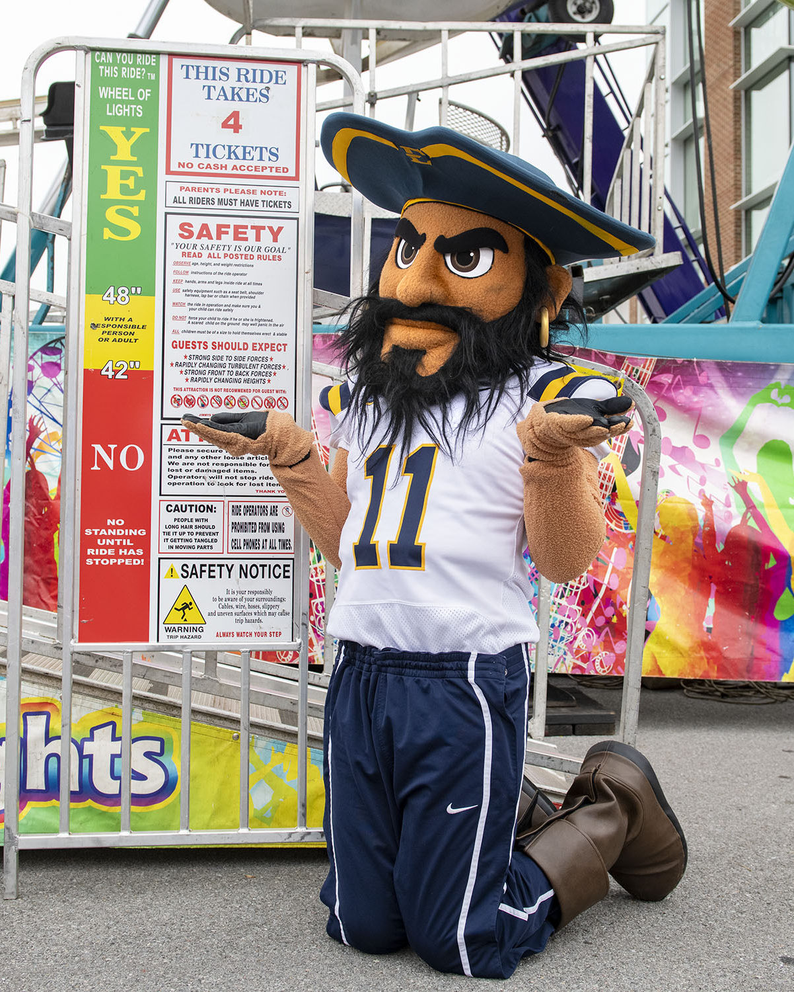
Is SAAC funding the right choice for my organization?
Student Activity funding is awarded to groups who use funding for
Student Activities (multiple) that would benefit your group AND other students on campus.
Operating expenses that would help your group promote, staff, and fund student activities.
Travel expenses that would help in the efforts toward your student activities.
Student Activity funding is not awarded to groups who use funding for
One major event.
Events that are exclusive to just your organization.
Travel costs to one event.
Only food costs.
Meeting expenses.
See the next slide for alternative sources of funding.

Slide 3
Alternative Funding Sources
SGA B.U.C. Fund
For one-time activity-specific requests.
SGA Seed Funds
For brand new clubs/organizations to help with start up costs.
Departmental Funding
For activities that are major-specific or related to academics.
ETSU School of Graduate Studies or the Office of Undergraduate Research
For grad and undergrad research projects and presentations at conferences.
ETSU Elevates
For students who need funding for a community project.
CLICK FOR MORE INFO
ON THE SGA WEBSITE
CLICK FOR MORE INFO
ON THE SGA WEBSITE
For more information, please contact your department chair
CLICK FOR MORE INFO ON THE GRAD & UNDER GRAD RESEARCH WEBSITE
CLICK FOR MORE INFO ON THE ETSU ELEVATES WEBSITE

Slide 4
How to Apply
Go to the SAAC website.
Read the SAAC Guidelines.
Fill out the Budget Spreadsheet.
  Located on the website.
Click on the link to fill out the SAAC application (in Dynamic Forms).
  You will upload your budget spreadsheet to this form.
Once completed be sure you receive a confirmation email with a copy of your application.

Slide 5
Filling out the Budget Spreadsheet
Total Income/Real: the amount of income you received for the current fiscal year.
Total Income/Anticipated: the total amount you anticipate to receive for the upcoming fiscal year - please include your requested saac allocation.
Expenditures/Real: the amounts spent on different expenses throughout the current fiscal year - if nothing was spent leave blank.
Expenditures/Anticipated: the amounts you anticipate to spend on different expenses during the upcoming fiscal year - if you were to receive the allocation you requested.
In the blue spaces you will need to provide details for each cost to better clarify.

Slide 6
Filling out the Application
Contact Information: your organizations main contact and individuals who will attend your hearing.
Budget Manager Information:
MUST BE A FULL TIME STAFF/FACULTY
See next slide for more information
Allocation Request & Excel Spreadsheet Information: Your requested allocation information, index number if funds received before, and where you will upload your budget spreadsheet.
Description of Organization and Scope of Activities: Your purpose, description, and student activity engagement justifications.

Slide 7
Budget Manager Requirement for Student Activity Funds
ETSU Full-Time Faculty/Staff advisor who can:
  Process purchase orders and payment requests with Procurement at ETSU
  Keep detailed records of expenditures and follow all ETSU accounting and documentation guidelines
  Be prepared to report how funds were used and participation in activities resulting from funding received
Funds will not be allocated to any group that does not have an approved designated budget manager.

Slide 8
Scheduling a hearing time
Once you have successfully submitted your application, we will be in touch to schedule a hearing time
Hearing Information
Zoom Only
10 minutes each
Each group will need to be in the zoom waiting room 5 minutes before their scheduled hearing time
You will receive an email with your hearing date and time normally within a week after the deadline for SAAC applications have ended.

Slide 9
What to expect during your hearing…
During your hearing you should be advocating for the funding you have requested
The committee may ask questions pertaining to certain costs they see in the budget breakdown, preparation for events, and overall student benefit if you were to receive funding.
Some groups will present slides or student testimonies about the benefits of what your organization is able to do and how much of an impact SAAC funding would be for your organization.
Your hearing is only 10 minutes which may seem short, but the committee has already looked over your application and budget spreadsheet before joining and will ask any questions they feel need more clarification.

Slide 10


Timeline after your hearing…
After all hearings are complete the committee will then meet to determine allocation amounts.
Once allocations are determined they are then sent for official approval through Student Life & Enrollment.
Shortly after you should receive your official notice of your SAAC award decision

Slide 11

Congratulations, your organization received Student Activity Funding!
Next steps…
If this is your first-time receiving SAAC funds you will need to schedule a time to meet with us to go over some important details.
If you have received SAAC funds before you will need to confirm the following:
  The index number your funds will need to go into.
  Your budget manager’s information.
  Verify you have access to view, access, and utilize these funds. (funds will begin to be distributed into indexes between July 1 to September 1)

Slide 12

If you didn’t receive funding…
DON’T WORRY!
We have plenty of other resources all across campus to help YOUR organization thrive and grow during the academic year!
Reach out to us and we can help connect you to the right people and resources needed!

Slide 13
Questions?
M Leah Adinolfi
Dean of Student Engagement/Director of Assessment
adinolfi@etsu.edu
423-439-6633
Vikki Hise
Office Coordinator
hisevs@etsu.edu
423-439-4286

