Slide 1
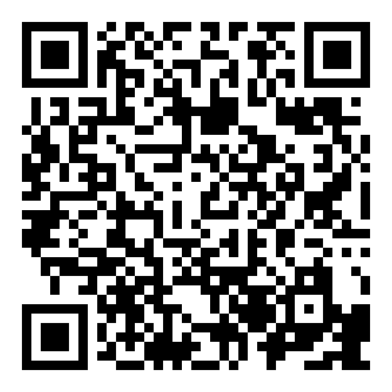
You’ve
got this!
with a free personal nurse -
A lot’s
gonna
change
Call/Text
(844) 637-6667
NFPinfo@etsu.edu

Slide 2

With your very own free Nurse-Family Partnership personal nurse, you will get the support, advice and information you need during your pregnancy
and when your baby arrives.
As a ﬁrst-time mom, you want the best start for you and your baby.
ETSU is an Equal Opportunity Educational Institution/Employer.
ETSU-240789-A-24.
Designed and produced by BMC Creative.

