Slide 1
Overview of Preceptorship
A Meaningful Leadership Experience
Presented by: College of Nursing Faculty
Preceptor Orientation Handbook
Notes:
Welcome to clinical teaching at ETSU. Your willingness to support the college of Nursing through provision of time and expertise supports our mission to facilitate the health of the community through excellence and innovation in nursing education, research, scholarship, creative activity, services, and practice.
The faculty thanks you and wishes to support you while you volunteer as a clinical preceptor. The purpose of this orientation is to provide direction for you in your preceptor role.
A complete preceptor orientation handbook can be printed for your reference at the website listed on this page.

Slide 2
Disclosure Statement
The College of Nursing faculty DOES NOT anticipate discussing the unapproved/ investigative use of a commercial product/device during this activity or presentation.

Slide 3

Learning Outcomes
Upon successful completion of this course, the preceptor will have the ability to…
Define Preceptorship
Relay the roles, responsibilities, and expectations of a preceptor, student, and faculty
Identify location of faculty contact information
Discuss the Preceptorship Triad
Comprehend the value critical thinking
Identify student learning style
Incorporate different teaching strategies into practice
Facilitate student success in clinical

Slide 4
Introduction
Preceptor and clinical site shortages are a well-known barrier to nursing education
Precepting is an opportunity to “give back” to the nursing profession.
Sharing clinical expertise is a leadership opportunity that sets the direction for the nursing profession’s future.
There is no better joy than to see a nurse flourish from a novice to expert (Benner, 1982).
“Those who know, do. Those that understand, teach.” (Aristotle)

Slide 5

Preceptorship
Preceptorship: “A one on one relationship of pre-determined length, between an experienced nurse (preceptor) and a novice (student) designed to assist the novice to successfully adjust to and perform the new role.”
(Yonge & Myrick, 2011)
(Canadian Nurses Association, 1995, p.13).

Slide 6

ETSU College of Nursing Preceptor Needs
Registered Nurse Students
Family Nurse Practitioner Students
Pediatric Nurse Practitioner-Primary Care Students
Psychiatric Mental Health Nurse Practitioner Students
Adult/Gerontology Acute Care Nurse Practitioner Students
Adult/Gerontology Primary Care Nurse Practitioner Students
Women’s Health Care Nurse Practitioner Students
Executive Leadership Students
Nursing Education Students

Slide 7
Legal Considerations
Nursing students function under the American Nurses’ Association of Professional Standards of Practice and Code of Ethics.
A student nurse must always have a preceptor present.
The student's preceptor and the faculty supervisor are responsible for ensuring that the actions of a student nurse are conducted in safe manner for the patient.
The nursing student must be deemed competent by the preceptor or faculty prior to delegation of tasks.
A student should not participate in a level of practice for which he or she is not prepared or supervised.
When in doubt of legalities surrounding a student’s performance, preceptor should take over patient care and never jeopardize patient safety.
Always follow the four basic principles of nursing ethics: justice, autonomy, beneficence, and nonmaleficence.
(ANA, 2017)
(ANA, n.d.)
(Bupert, 2012)
Notes:
The preceptor orientation handbook discusses the regulations of registered nurses and the ana code of ethics

Slide 8
Principles of Nursing Ethics
Principle | Definition
Autonomy | Respect and acknowledgement of a person’s rights to: make decisions, hold a personal viewpoint, take action based on their personal viewpoint and beliefs.
Justice | Treatment of others equitably and distribution of benefits and burdens fairly
Nonmaleficence | Do no harm to others
Beneficence | To do good for others

Slide 9
Precepting for ETSU
The student may perform tasks that would constitute the practice of nursing.
The student is responsible and accountable for the safe performance of those direct client care tasks to which he or she has been assigned.
Faculty are responsible to ensure students are only performing skills for which they have received instruction and have been found proficient.
Skills checklist shall be maintained by each student in project concert.
Preceptors/faculty shall monitor clinical performance and intervene if necessary for the protection of clients.
Preceptors may not delegate the duties of preceptorship.
Preceptors have current, unencumbered states license and national certification.
Preceptors may not supervise more than two students at any given time.

Slide 10
Preceptorship Triad
Nursing Faculty : A nurse instructor that teaches and serves in a university or college setting.
The nurse faculty serves the following roles:
Facilitator of clinical learning experiences
Evaluator
Overall responsible party for student learning
Communicator
Resource for student and preceptor
Nursing Preceptor: A nurse who teaches and educates in the clinical or practice setting. The nurse preceptor serves the following roles:
Role model
Teacher
Facilitator
Guide
Evaluator
Safety net
Being authentic
Triad
Nursing Student: An active learner who seeks the knowledge of the profession.
The student nurse serves the following roles:
Professional
Reliable
Accountable
Self-evaluator
(Yonge & Myrick, 2011)
(Wilks University, 2014)
(University of Minnesota, 2017)

Slide 11
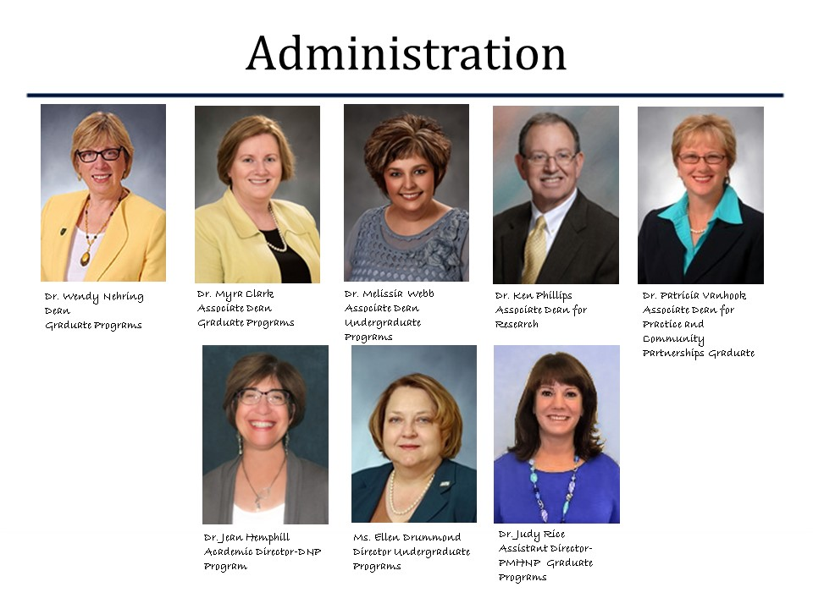
ETSU College of Nursing

Slide 12
Program Directors/Assistant Director Roles
Provide oversight, leadership, development and planning for academic, clinical, and community relationships.
Sustain existing relationships by developing and maintaining partnerships
Foster partnerships in the academic-clinical community environment
Engage as a clinical teaching partner
Identify benchmarks for College of Nursing partnership involvement

Slide 13
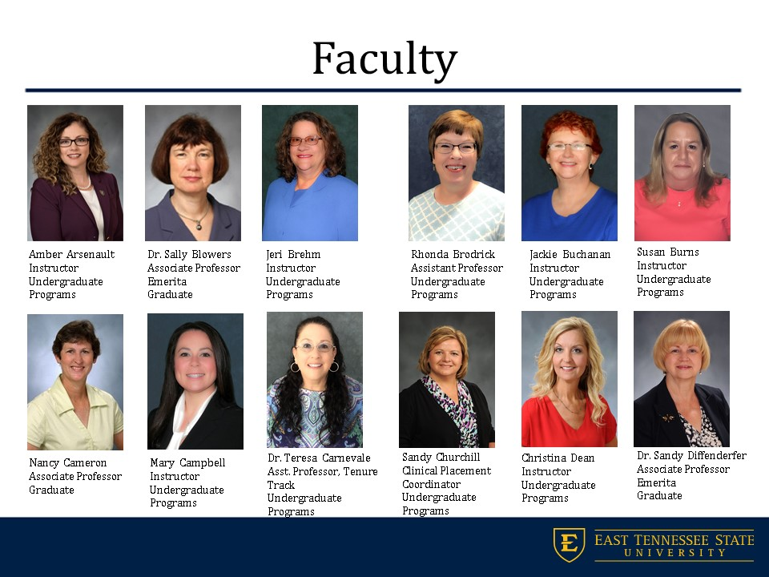

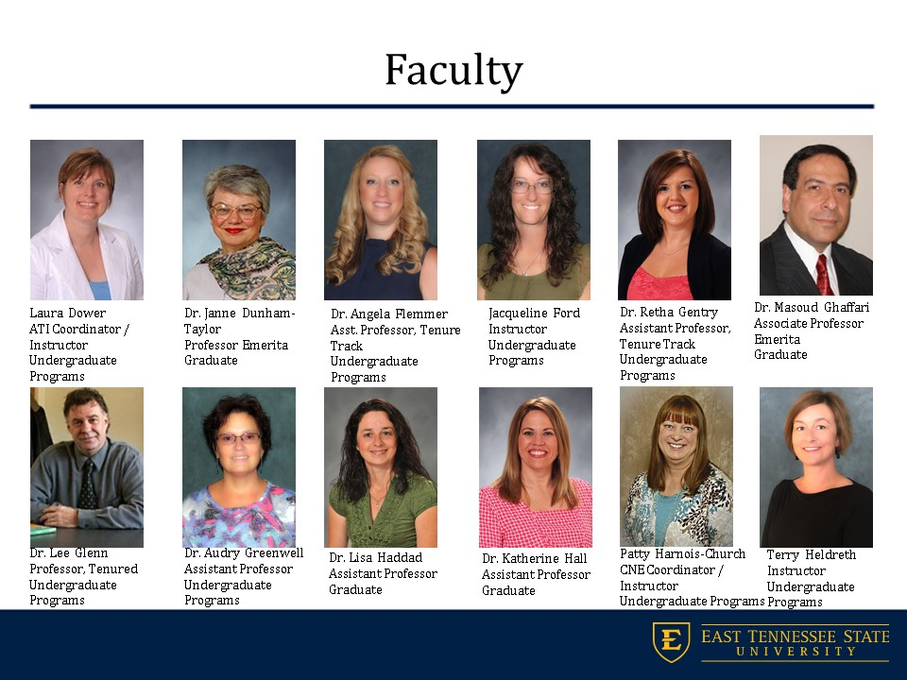
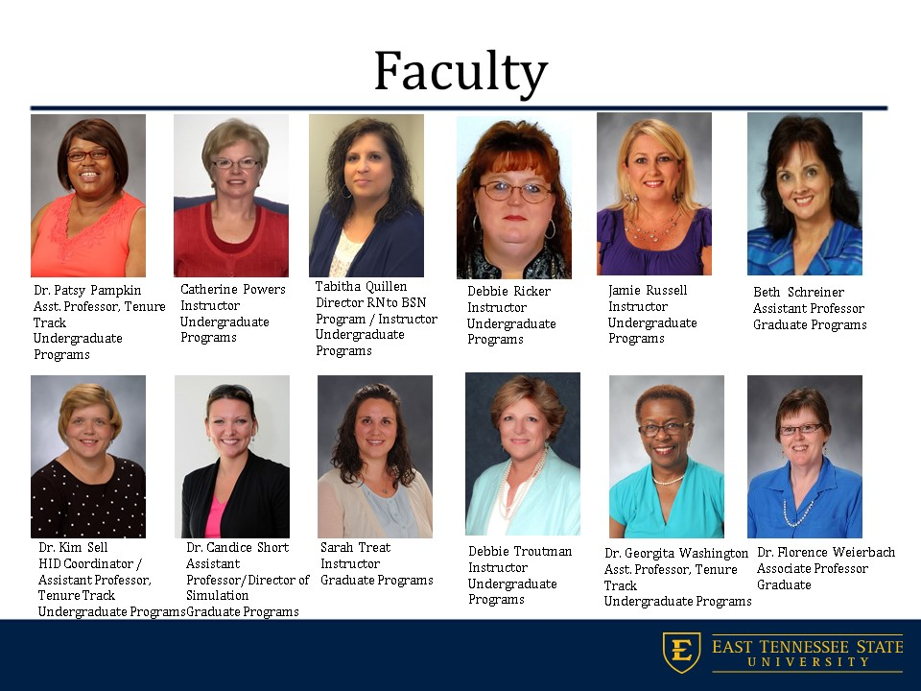
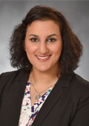
Faculty
Dr. Meira Yasin
Asst. Professor, Tenure Track
Undergraduate Programs

Slide 14
Faculty Role
To ensure that the student meets the course objectives
Available for communication/consultation with the preceptor/student during clinical time.
Sequencing of course content and assignments
Assignment of final grades
Verify and agreement is in place with clinical site
Provides the student with the basic preceptor orientation and syllabus
Serves as a resource for student and preceptor
Maintains confidentiality when posting clinical assignments compliant with HIPAA.
Ensures clinical experiences are appropriate level for students
Performs student evaluations
Expresses appreciation to preceptor for precepting student
Notes:
positive public relations with the units/agencies. k. Sends acknowledgments of appreciation to each unit/agency at the end of the semester.

Slide 15
Faculty Contact Information
Faculty contact information is located on the syllabus that the student provides at the beginning of the semester. Here are three other ways to attain faculty contact information:
1. Faculty contact information: website
Or
2. Call Student Services: 423-439-4578
Or
3. Email: nursing@etsu.edu

Slide 16
Faculty/Clinical Coordinator Role
Recruit qualified preceptors for students
Facilitates preceptor participation in events/retreats
Coordinates preceptor activities
Serves as a resource for preceptor and student during the clinical rotation.

Slide 17
Clinical Site Placement
Clinical site placement at the Graduate Level is coordinated between the student, course professor, clinical site coordinator (if applicable), and program coordinator.

Slide 18
Preceptor Role
Provide supervision of student during all patient encounters and treatment plan development
Foster critical thinking
Immerse student in clinical practice experiences
Discuss student learning objectives daily
Assess student performance
Verbal feedback on student performance of care
Complete a mid semester and final evaluation of student
Inform clinical faculty when there are issues or concerns related to student performance
Make progress toward the course objectives
Identify clinical experiences to enhance the student’s learning experience
Reviews and approves all student clinical experiences in project concert

Slide 19
Student Role
Adhere to all policies an guidelines in the College of Nursing Student Handbook and clinical guidelines
Establishes individual learning objectives using the course objectives as a guide
Maintains skills checklist detailing performance of skills
Collaboration with faculty and preceptor
Schedule clinical hours with preceptor and shares with clinical faculty
Notifies preceptor and clinical faculty is clinical scheduling changes
Functions within the legal and personal limitations in the student role
Seeks guidance when needed
Identify knowledge deficits
Participates in self evaluation and evaluation of preceptor
Participates in the faculty/perception student evaluation process.
Notes:
clinical faculty (undergraduate).

Slide 20
Curriculum
Preceptors must be familiar with their student’s program of study
Go to: http://www.etsu.edu/nursing/default.php
Select graduate or undergraduate programs
Select your student’s program
Select Program Curriculum and review program of study
Clinical courses provide the student opportunity to demonstrate competency in the clinical practice environment
Prior to clinical, the student completes simulation-based learning to begin the process of skill acquisition
In clinical the student will learn tasks, communication, emotional intelligence, teamwork, and collaboration.
Each practicum course builds on skill achieved in previous courses
Students are held accountable for sustaining and advancing their knowledge.
The simulation center is available for students to practice skills as appropriate
Notes:
Prior to enrolling in the clinical courses, students complete simulation-based learning coursework to begin the process of skill acquisition. Skills include psychomotor skills (tasks), professional and therapeutic interpersonal skills (communication), and organizational skills (emotional intelligence, teamwork, and collaboration). Each course builds on skills achieved in previous courses, and students are accountable for sustaining and advancing their learning. The simulation learning center is available for students to return and polish their skills as appropriate.

Slide 21
Evaluations
ETSU requires students evaluation by preceptors and faculty
There are two common types of student evaluations used in precepting:
  Formative : evaluation of a certain skill, clinical day, or knowledge about a subject, and used to complement a summative evaluation
  Summative: evaluation of the overall competency of the student
A mid-semester evaluation is an example of a formative evaluation and is conducted to monitor the student’s progression in the clinical practicum. Doing a formative evaluation allows time for remediation if needed.
The preceptor should notify faculty when remediation is needed so the triad can construct a formalized remediation plan.
The final-semester evaluation (summative evaluation) is conducted to see if the student meets the overall competencies for the semester and passes the course.
Faculty evaluations may be conducted by Skype for Business, verbal communication, or on site.
Formal student evaluations ensures that the student is competent with the clinical practicum course’s student learning outcomes.

Slide 22
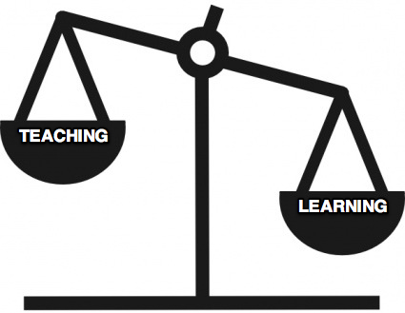
Teaching Pointers
For
Preceptors

Slide 23

Is precepting for me?
Is precepting for you? | Yes | No
Ability to share your patients and their care with others?
Practice evidence based care with excellent clinical outcomes?
Have not forgotten what it is like to be a student?
Supportive and encouraging demeanor?
Confident and enthusiastic?
Healthy work environment?
Effective time manager?
Professional behavior?
Need continued education hours for recertification?
Coaching experience?
Ability to give positive/negative feedback?
Good communication skills?
Time to share experiences?

Slide 24

When not to precept?
No interest in teaching
Burnout
No patience with learners
Poor self-confidence
Student is friend or relative
Less than one year’s experience in your role
Site with student’s relatives in administrative roles
Site of student’s employment

Slide 25

Professional Relationship
Set professional boundaries.
Do not develop a personal relationship in clinical practicum.
Treat all students with the same professional standards.
Build trust with the student.
Share work related experiences with the student.
If the student has personal problems, refer them to the relevant resources for help.
Discuss any concerns with the student’s performance with the clinical faculty, contact information is located on the syllabus.
(Yonge & Myrick, 2012)

Slide 26

Adult Learning
Malcom Knowles (1984) identifies four key features of the adult learner:
Involvement in the planning of instruction.
Experience provides the basis for learning activities
Adults want to learn subjects relevant and that impact their job or life
Problem centered, not content-oriented.
How will the adult student learn best?
Visual
Auditory
Kinesthetic
Have your student take the VAK Learning Style Inventory to decide how the student learns best. This gives the preceptor insight on the best teaching method for the student to learn.
(Knowles, 1984)
(Chapman, 2017)

Slide 27
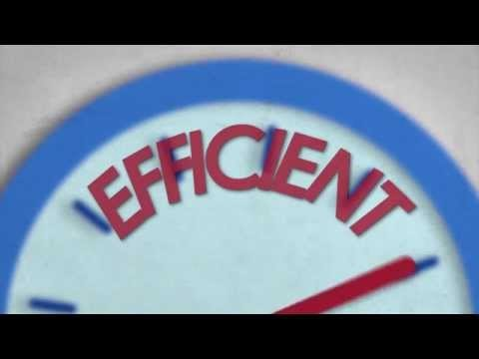
Evidence Based Preceptor Model
One Minute Preceptor

Slide 28
Other Videos Demonstrating the One Minute Preceptor
https://vimeo.com/118248470
https://vimeo.com/118248476
https://vimeo.com/118248471
https://vimeo.com/153056353
https://vimeo.com/151705946

Slide 29
Learning Strategies
Video
Demonstration
Lecture
Concept Mapping
Teach back method
Textbooks/Resources
Algorithms
Conversation
Visual aids
Simulation
Standardized patients
Practice
Repetition
Teaching others
Research
Websites
Epocrates
Mnemonics
Research
Feedback
Debriefing
Reflection
Discussion
Written Assignments
Reading Assignments
Webinars
Podcasts
Case Studies
Conceptual Exploration
Explanation
Concrete Exemplars
Guidelines
Database Searching
AHRQ
Brainstorming
Consultation
Interprofessional Consultation
Group Activities
Models
Quizzing
Note taking
Visual notes
Writing
Ordering
Presentation
Reports
SOAP Notes
Faculty consultation
Professional Organization Exploration
Up to date
Verbal/Written Feedback

Slide 30
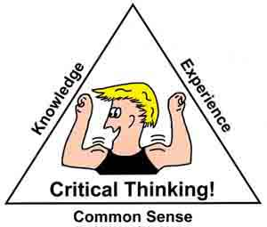
Teaching Critical Thinking
Critical thinking is defined as purposeful, informed, results-oriented thinking requiring careful identification of problems, issues, and risks.
Critical thinking is enhanced with knowledge, experience, skills, and intuition.
Critical thinkers reevaluate, self correct, strive for improvement, imagine alternatives, reflect, visualize the entire picture, and wonder why you respond to situations the way you do.
All nursing students should be prompted and encouraged to critically think.
(Yonge & Myrick, 2012)

Slide 31
Fostering Critical Thinking in Preceptorship
Preceptor
Staff
Purposive
Incidental
Valuing
Open, approachable, respectful, confidence in preceptee
Supporting
Safety Net, encourages, self reliance, autonomy, individualized approach
Working With
Collaborative, reciprocal, honest, empathetic
Climate
Accepting
Likes having students, supportive, good rapport with preceptee
Role Models: “Is the way”
Provides clarity, is consistent, “real”, and accessible
Facilitates “Paves the Way”
Identifies needs, defines goals, evaluates
Guides: “Shows the Way”
Tailors experiences, optimizes learning opportunities
Prioritizes: “Sets the Way”
Organizes care, considers alternatives, gives gentle feedback
Questions Knowledge Base
Enhances depth & breadth of understanding: promotes use of scientific rationale
Decision –making
Fosters insight, develops problem-solving
Actions
Sparks intellectual curiosity, develops awareness, promotes safe & competent care
Bringing About
(Yonge & Myrick, 2012)

Slide 32
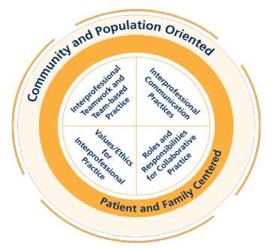
Teamwork/IPE Experiences
There are four Interprofessional Education Core Competencies (IPEC, 2016)
  Communication
  Ethics/Values
  Role/Role Responsibilities
  Teamwork/Team-based care
All levels of students need interprofessional learning experiences in clinical . There are many ways that you can give your students these experiences:
  Demonstrate effective collaboration with other departments
  Allow your student to be involved in transitional care
  Let your student communicate with other disciplines when needed for patient care (pharmacy, medicine, speech therapy, respiratory therapy, audiology, etc.)
  Quiz the student about possible consultations to care for patients
  Allow the student to collaborate with other disciplines
  Allow your student to interact with lab, case managers, social workers.
  Teach your student about the roles of every discipline working with you

Slide 33

Constructive feedback…
Praise your student for a job well done.
Reinforce positive and appropriate behavior.
Discuss professional development
Explain the growth curve from novice to expert
Did you meet the student’s learning outcomes or personal goals?
Give feedback in private
Negative feedback should focus on facts and specifics of the situation
Use even, calm tone of voice
Do not mix positive feedback with negative feedback—it may then be seen as criticism.
Do not blame or criticize
Check your student’s understanding after feedback
Come up with resolutions
Be supportive
Conduct formative and summative evaluations:
A formative evaluation—example daily debriefing on how well the student performed today.
A summative evaluation—example would be a overall end of the semester evaluation

Slide 34
Protection of Patient Health Information—HIPAA
Students are often given assignments requiring review of patient information. It is important to ensure that the student is in compliance with HIPAA regulations.
The Health Insurance Portability and Accountability Act of 1996 (HIPAA) is a federal law that sets national standards for the protection of patient information known as protected health information.
HIPAA requires the preceptor, faculty, and student to protect patient information in all settings: academic, clinical, and elsewhere. The HIPAA rules protect the patients’ demographic information, billing information and treatment information.
Any information that identifies a patient must be protected!

Slide 35

18 HIPAA Identifiers
Students may not record any of the following patient identifiers for practicum assignments:
Names
All geographic subdivisions smaller than state
All dates related to an individual, including DOB, admission date, discharge date, death date, and all ages over 89
Telephone numbers
Vehicle identifiers and serial numbers including license plate numbers
Fax numbers
Device identifiers and serial numbers
Email addresses
URLs
IP addresses
Social Security Numbers
Medical Record Numbers
Biometric identifiers, including finger and voice prints
Health plan beneficiary numbers
Full-face photographs
Account numbers
Any other unique or identifying characteristic, number or code
Certificate or license numbers

Slide 36
FAQ
Where can I attain more precepting information about my student discipline?
Preceptor Orientation Handbook for Graduate and Undergraduate Programs
Where can I learn more about precepting for ETSU?
ETSU Preceptor Resources Website
Where do I learn how to use project concert to sign off my students clinical experiences?
ETSU Preceptor Resources Website
Who can answer my questions about project concert?
Contact Mark Bodo, IT Manager
bodomn@etsu.edu
phone at 423-439-4579.

Slide 37
Additional Online Resources
Academic Practice Partnerships | http://www.aacnnursing.org/Academic-Practice-Partnerships
Core Quality Measures | https://www.cms.gov/Medicare/Quality-Initiatives-Patient-Assessment-Instruments/QualityMeasures/Core-Measures.html
DNP Essentials | http://www.aacnnursing.org/DNP/DNP-Essentials
ETSU CoN DNP Program Website : Student handbook and clinical documents | http://www.etsu.edu/nursing/default.php http://www.etsu.edu/nursing/learning_recourses/condocuments.php
Gerontology Preceptor Toolkit | https://www.gapna.org/resources/toolkit-gerontology-resources-advanced-practice-nurses
HIPAA | https://www.hhs.gov/hipaa/index.html
HEDIS Quality Measures | http://www.ncqa.org/HEDISQualityMeasurement/HEDISMeasures/HEDIS2015.aspx
Interprofessional Education Core Competencies | https://nebula.wsimg.com/2f68a39520b03336b41038c370497473?AccessKeyId=DC06780E69ED19E2B3A5&disposition=0&alloworigin=1
JCAHO | https://www.jointcommission.org/
Learning Theories | http://www.learning-theories.com/
Learning Style Inventory | http://www.personal.psu.edu/bxb11/LSI/LSI.htm#ShowResults
NONPF Competencies | http://www.nonpf.org/?page=14
NONPF Preceptor Portal | http://www.nonpf.org/?page=PreceptorPortal_Main
One Minute Preceptor | http://nursing.unc.edu/files/2012/11/ccm3_030611.pdf
Preceptor Certification | http://www.preceptoracademy.com/
QSEN Competencies | http://qsen.org/competencies/
Rapid Cycle Quality Improvement Recourse Guide | http://www.healthworkforceta.org/resources/po-resource-center/rapid-cycle-quality-improvement-resource-guide/
UDS Measures | http://www.bphc.hrsa.gov/datareporting/reporting/index.html

Slide 38

Take home points…
Attain syllabus from student
Review course objectives
Review Student Learning Outcomes
Review faculty contact information
Create a clinical rotation plan with student (schedule)
Determine the student’s learning style
Discuss student’s personal learning goals
If there are no further questions regarding precepting the College of Nursing Student, clinical instruction may begin.

Slide 39

Questions…
Questions about precepting an ETSU College of Nursing Student?
For information regarding course, student, or precepting contact the student’s Clinical Faculty.
For general information, contact:
Student Services
423-439-4578
Nicks Hall, Room 241
P.O. Box 70664
Johnson City, TN 37614
nursing@etsu.edu

Slide 40


Slide 41
References
American Nurses Association. (2017) Code of ethics. Retrieved from http://www.nursingworld.org/codeofethics
American Nurses Association. (2017). Standards of practice. Retrieved from http://www.nursingworld.org/nursingstandards
American Nurses Association. (n.d.). Short definitions of ethical principles and theories: Familiar words what do they mean? Retrieved from http://www.nursingworld.org/MainMenuCategories/EthicsStandards/Resources/Ethics-Definitions.pdf
Benner, P. (1982). From novice to expert. American Journal of Nursing, 82(3), 402-407
Canadian Nurses Association. (1995). Preceptorship resource guide: Teaching and learning with clinical role models. Ottawa: Author.
Chapman, A. (2017). VAK learning styles test. Retrieved from http://www.businessballs.com/vaklearningstylestest.htm#authorship-referencing
Knowles, M. (1984). The Adult Learner: A Neglected Species (3rd Ed.). Houston, TX: Gulf Publishing.

Slide 42
References
Myrick, F. & Yonge, O. (2011). Guide to preceptorship. University of Alberta Faculty of Nursing. Retrieved from https://www.ualberta.ca/nursing/about
University of Minnesota. (2017). Preceptor, student, and faculty role responsibilities. Retrieved from https://www.nursing.umn.edu/outreach/clinical-preceptors/general-preceptor-information/preceptor-faculty-and-student-roles-and-responsibilities
Wilks University. (2014). Nurse preceptor a vital role. Retrieved from http://onlinenursing.wilkes.edu/nurse-preceptor-vital-role/
Bupert, C. (2012). Who is responsible for the actions of the student nurse? Medscape. Retrieved from http://www.medscape.com/viewarticle/763438

