Slide 1
ETSU IRB
CITI Human Subjects Training Instructions

Slide 2
Before You Begin:
If you have current IRB training, you are not required to complete the CITI modules prior to your current training expiration. CITI training is valid for three-years from date completed.

Slide 3
First Time Users of CITI Training Program
Go to www.citiprogram.org
Select “Register” on the right hand side.
Under “Select Your Organizational Affiliation” type East Tennessee State University. (Once you begin typing “East,” you should see a list of schools and can select from the list). Training will be free of charge.
  If you need to do CITI for VA purposes, you need to select ‘VA Mountain Home, TN-621’.

Slide 4
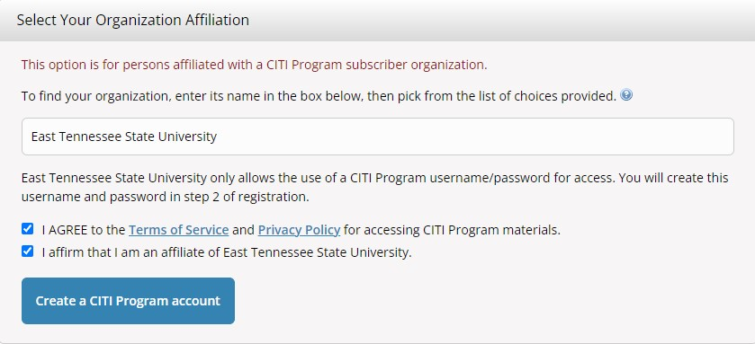
First Time Users of CITI Training Program
4. Check the ‘I Agree’ and ‘I affirm’ box, and continue to create your CITI program username/password.

Slide 5
First Time Users of CITI Training Program
5. DO NOT select “Independent Learner Registration” as fees will apply
6. Complete the following screens, selecting the “Continue” button after each:
Personal Information
Create your Username and Password
Security Question and Answer
Country of Residence
Continuing Education Units
Information requested by East Tennessee State University

Slide 6
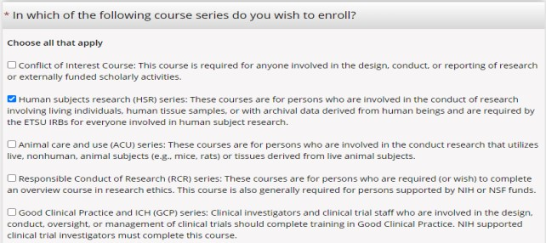
First Time Users of CITI Training Program
7. For Human Subjects Research, select ‘Human subjects research (HSR) series’ or you can select another training module.

Slide 7
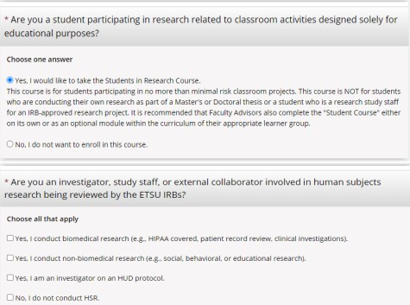
First Time Users of CITI Training Program
8. Answer whether this is for classroom activities or research and answer follow up question.

Slide 8
First Time Users of CITI Training Program
Section above indicates:
Option 1 = Human Subjects Research (HSR) – Biomedical Research
Option 2 = Human Subjects Research (HSR) – Social Behavioral Educational Research
Option 3 = Human Subjects Research (HSR) – HUD Investigators only

Slide 9
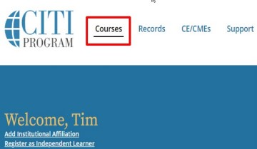
First Time Users of CITI Training Program
9. Select the blue “Finalize Registration” button to complete enrollment.
10. From the CITI dashboard, click “Courses”

Slide 10
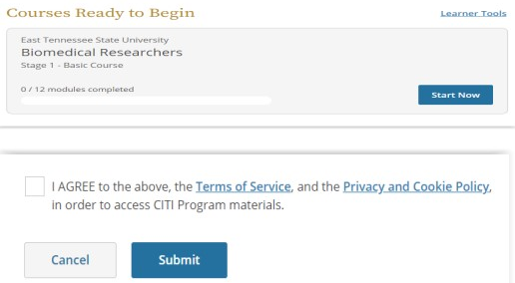
First Time Users of CITI Training Program
11. Select the blue “View Courses” button
12. To begin the course(s) you have selected: select the blue “Start Now” button, select the “I AGREE to the Terms of Service box, and submit.

Slide 11
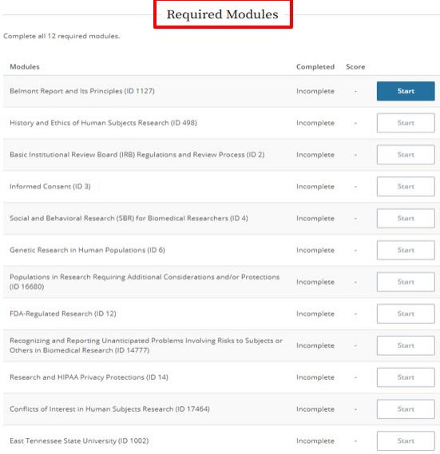
First Time Users of CITI Training Program
14. Complete all the required modules within the selected course. All modules in a required course must be completed to earn a certificate.
*An overall score of 80% of better is required for a passing grade
*Below the required courses you will find supplemental modules that you can choose to take if you are interested in taking those

Slide 12
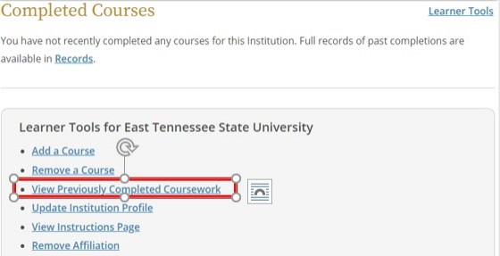
First Time Users of CITI Training Program
15. Choose “View Previously Completed Coursework”.

Slide 13
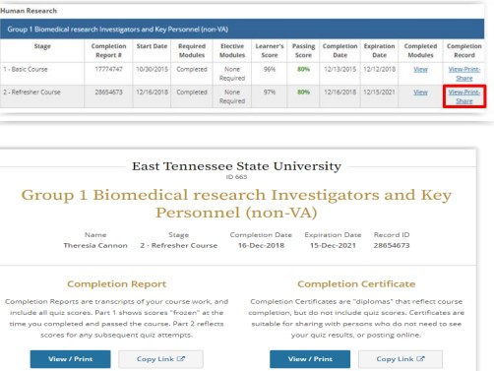
First Time Users of CITI Training Program
16. It is important that you print your completion report after finishing the test on the last module to save for your records. Choose “View Print Share” and select an itemized list of completed modules or print a certificate.

Slide 14
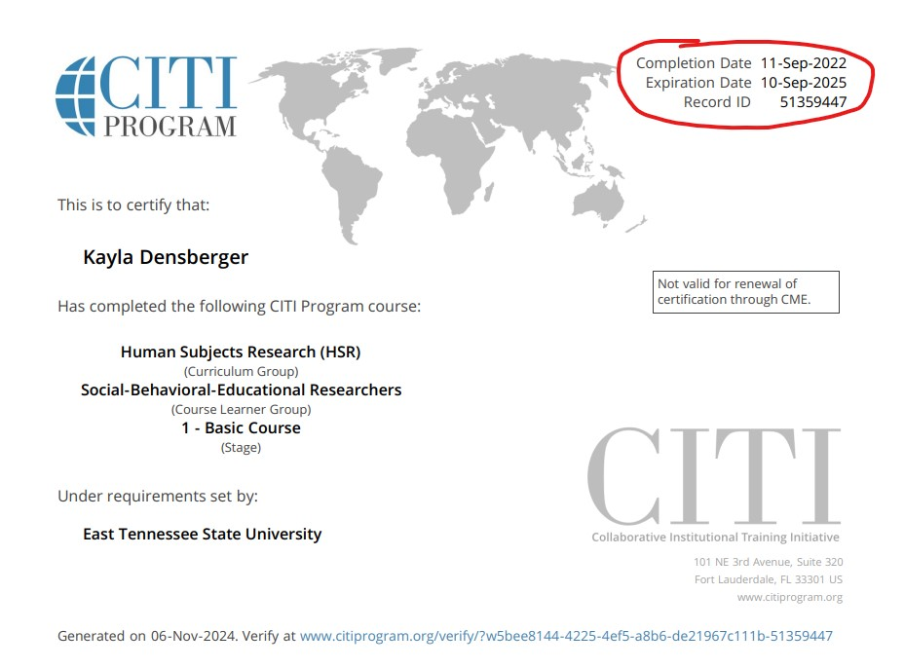
First Time Users of CITI Training Program
17. If you identified as a researcher when you chose your courses, your certificate will show a completion and expiration date. If you chose HSR as a class activity, your certificate will not show an expiration date.

Slide 15
Registered users who wish to renew their training

Slide 16

First Time Users of CITI Training Program
1. If you have already registered at CITI, enter your username and password and select “Login”.
2. If you are eligible to complete a refresher course, it will appear on your dashboard.

Slide 17
First Time Users of CITI Training Program
3. If you do NOT see a refresher course on your dashboard but you know that your CITI training has expired, select “Add Course” to choose the appropriate course.
4. Complete the required modules and save/print a copy of your completion certificate.

