Slide 1
ETSU General Scholarship Application Guide
2021-2022 Academic year

Slide 2

Apply to ETSU first at www.etsu.edu/admissions
ETSU's scholarship information can be found at www.etsu.edu/scholarships
The General Scholarship Deadline is March 1! Please apply early so you don't miss the deadline!
  Some scholarships may have other deadlines. Make sure to check all dates.
The scholarship application for the 2021-2022 academic year opens October 1, 2020.

Slide 3

At the bottom of the home page, you can see the different scholarships offered and information about important deadlines.
You can click the different circles to learn more about different scholarships
Each button will open a tab with links to important information, such as applications, requirements, etc.
Many of these scholarships use the General Scholarship Application
Complete the General Scholarship Application by March 1!

Slide 4

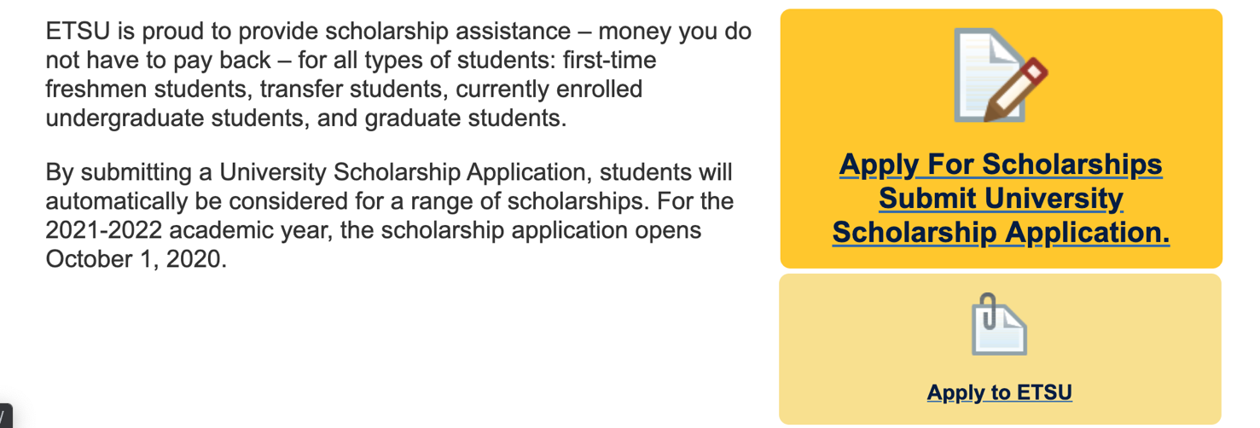
Step 1: Click "Apply for Scholarships Submit University Scholarship Application"
www.etsu.edu/scholarships

Slide 5

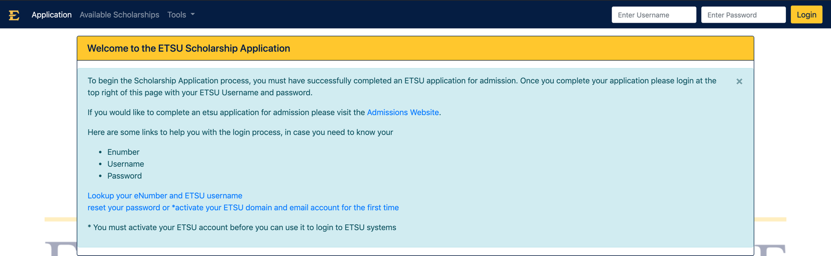

Step 2: Log in with ETSU username and password
Log in Here
Link to activate account
You will need to log in using your ETSU username and password. You must have completed an ETSU application for admission and be accepted in order to receive an ETSU username and password. You must also activate your ETSU account. If you do not know your username, E-number, or password, there are links on this page to locate it for you. There is also a link to activate your account.

Slide 6
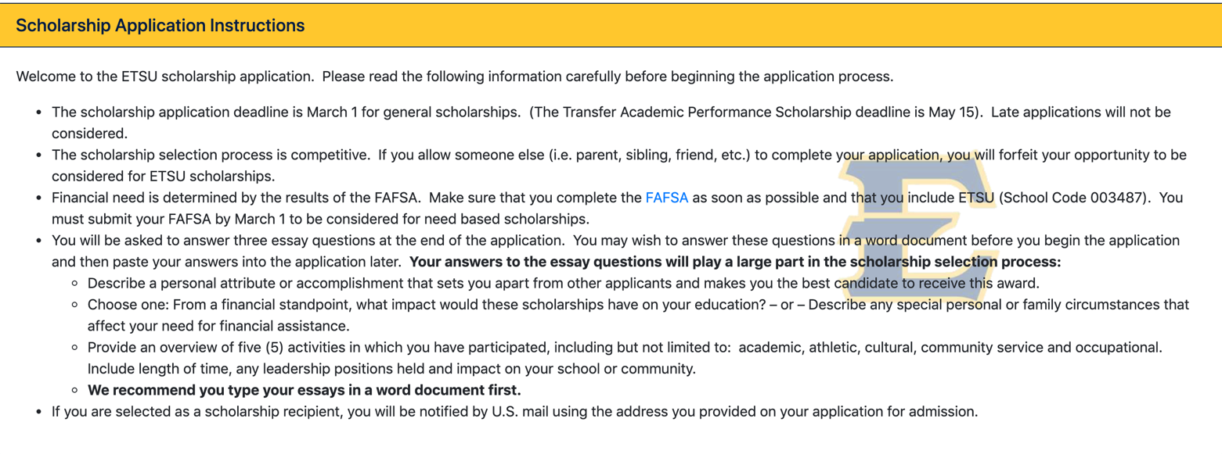
Step 3: Read Instructions Carefully, Write your essays in a word doc first.
At the top of the application page are guidelines and instructions for the application. Please read them carefully. Some key points are: 1) The deadline is March 1 for general scholarships, and May 15 for Transfer APS, 2) Do not allow someone else to complete your application or you will be forfeited, 3) Your financial need will be based on your FAFSA, 4) You will need to answer 3 essay questions for your application. It is best to type these in a Word Document first, and then you can paste your essays in the application after. This protects you from losing your essay progress if the page crashes.

Slide 7

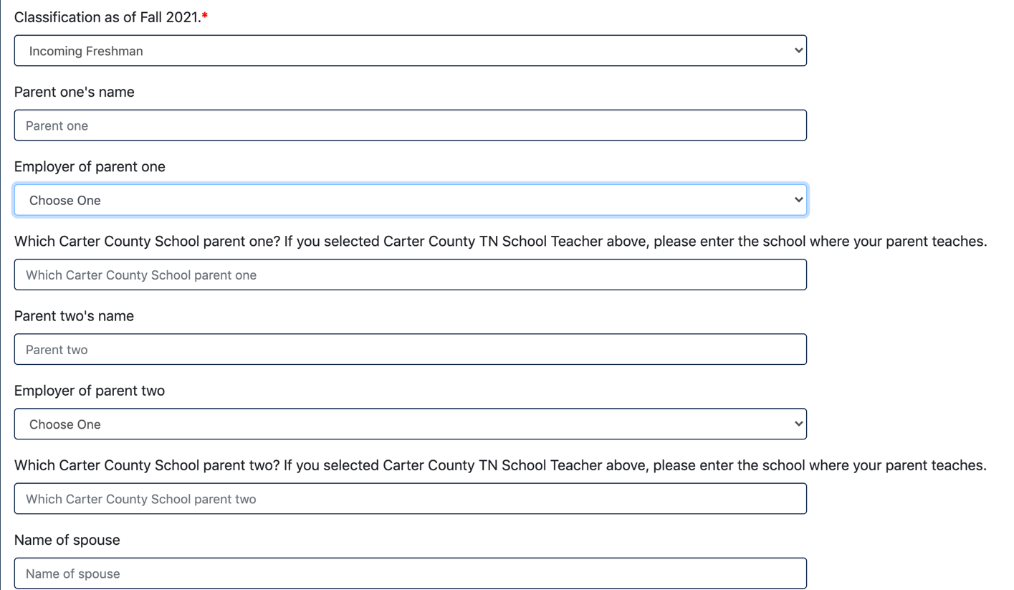
Step 4: Fill out information completely & accurately. Do not leave blanks.
Make sure to select your correct classification. For example, if you are a first-time freshman in college, select "Incoming Freshman" from the drop-down list.
Fill out the information completely and accurately. Do not leave blanks.
For any fields that are not applicable, put N/A

Slide 8
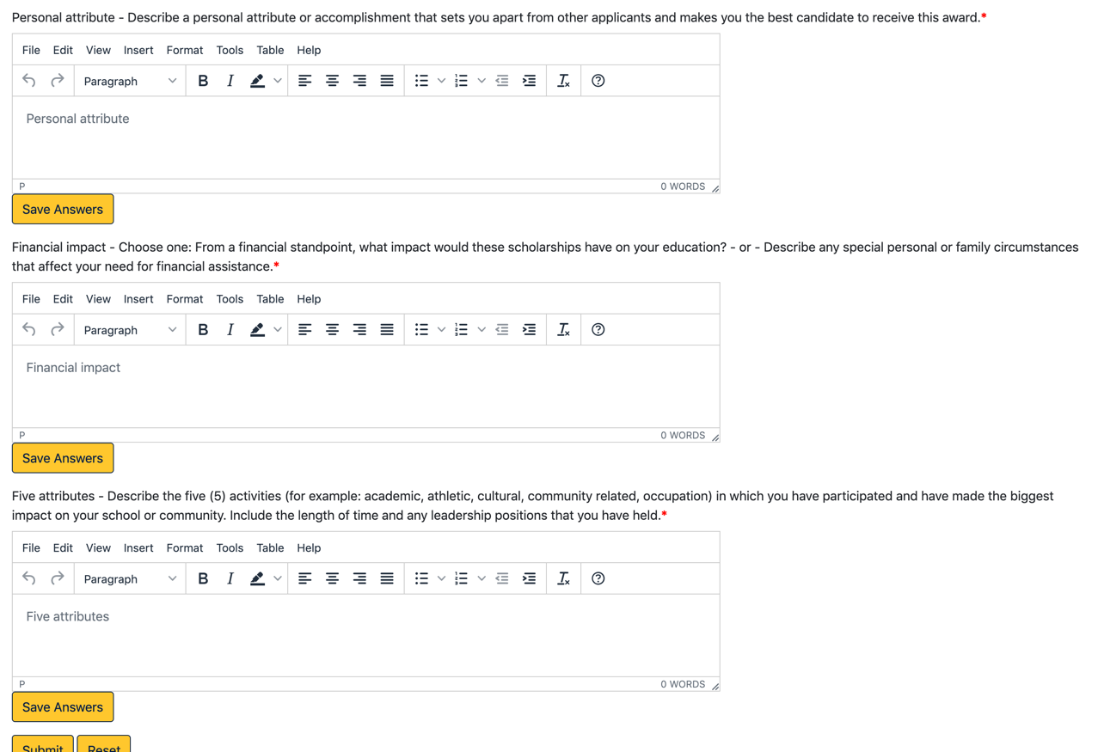
Step 5: Essays
At the end of the application, you will have to answer all three essay questions.
Your answers to the essay questions play a large part in the scholarship selection process, so please allow yourself enough time to answer them thoughtfully.
It is highly recommended that you write your answers in a Word Doc first, and then paste them onto the application after.

Slide 9
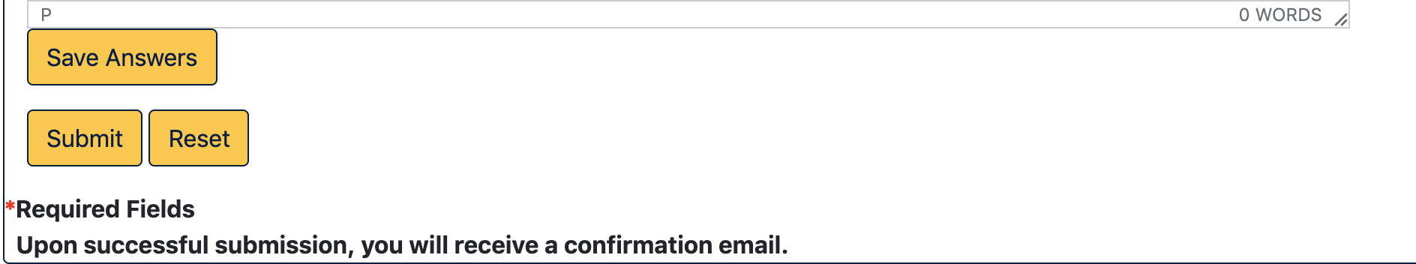
Step 6: Review & Submit
Review your information carefully before submitting your application
Check your essays for grammar, typos, and spelling
Be sure to provide the correct address. You will be notified if you have received a scholarship by mail.
Once you are ready, click the gold "Submit" button at the bottom of the application, under the essays.

Slide 10
Tips: Scholarship Office
You should receive an email right after you submit your application. Make sure you check to see if you received it. If you don’t receive it in the next 24 hours, you might want to contact the Scholarship Office at 423-439-7094.
You can also contact the Scholarship Office at 423-439-7094 or scholarshipoffice@etsu.edu if you have questions.

Slide 11
Tips: FAFSA
Please fill out your FAFSA as soon as you can. You will need to go to www.fafsa.ed.gov .
FAFSA Tip: It is advisable to transfer your income tax information directly from the IRS using the IRS Data Retrieval process. Do not make changes to the transferred information.
Simple steps to Transfer Tax Information Into Your FAFSA
FAFSA Tips and Common Mistakes to Avoid
If you have questions, you can find your counselor’s contact information at http://www.etsu.edu/finaid/counselors.php.

Slide 12

Contact Us for Support
The Mary V. Jordan Multicultural Center cares for your success and positive experience at ETSU. We want your transition from high school to college to be as smooth as possible.
If you have more questions or need more assistance, please feel free to contact us:
  Chloe Dalton, Graduate Assistant, Coordinator of Discover ETSU
    DiscoverETSU@etsu.edu
  Carshonda Martin, Director of Multicultural Center and Access & Success Programs
    MartinCH1@etsu.edu
  Nathnael (Nate) Tadesse, Coordinator of Mentoring and Access & Success Programs
    Tadesse@etsu.edu

