Slide 1
Planning Facilitation that Engages Students in Collaborative Learning
CHIIPS 2024
Notes:
Intro yourself when you start your section
Caroline - 5 minutes - warm up ?'s
Amy - 5 minutes - goals, intro to scenario & activity
All walk room and role model coaching - Activity 20 minutes to complete worksheet as instructed (ease drop & note discussions not reported; keep on task / move forward; clarify instructions; engage with toosl/resources provided)
20 minutes of reporting with response and wrap up

Slide 2
Warm-Up Questions
What questions did you hope to have answered in this session?
If you have been teaching in the active environment, what kinds of challenges have you been facing?
Notes:
Menti ? Can the poll be embedded in here? - up as entering room to answer
Caroline

Slide 3
GOALS
Discuss strategies for engaging students effectively in an active learning environment
Discuss classroom management in context of other active learning challenges
Discuss managing the active learning environment
Plan an active learning session
Notes:
Caroline

Slide 4
What are some challenges to implementing active and collaborative learning?
Chaotic environment (especially in large courses)
Coaching & Managing Groups
Quality of pre-class materials and activities
Quality of in-class activities
Discomfort
Notes:
Caroline
Cover any not brought up in Menti.
Speak to importance of context (the why) so they are prepared to know it will be uncomfortable - normalize discomfort for faculty and student - faculty are losing control and having to trust the process, they have fear and anxiety – content experts not teaching experts; students need context to understand the why and their experiences will modify the report out / debrief

Slide 5
PLANNING SCENARIO
SCENARIO: In the fifth week of a course, you are asked to teach a 2-hour class session that asks students to explore issues related to Social Determinants of Health. The course director shares with you that students seem more restless in class lately. The director indicates students are talking about personal or unrelated information during group discussion. There are even moments when students disengaging from required activities altogether. Plan a class session that responds to the learning needs of students and the context in which they are learning.
Notes:
Amy – scenario & activity intro (5min)
Cross will find a music clip to bring group back together following the scenario review; then hand out worksheet for activity; give 20 minutes to plan event. Provide QR code to WHO website if need background on SDoH (provide iHELP tool).
Each group will have a # highlighted as their # to start on (so all groups start in a different place and each question is covered)

Slide 6
Process Outcomes
Values & Ethics
Roles & Responsibilities
Communication
Teams & Teamwork
Respect & Collaboration
Investigation & Information Finding
Empathy
Notes:
Alicia leads report out:
Learning outcomes were provided (objectives), but now we will focus on process outcomes
These are essential skills - what you gain from participating in the process of this activity
When report out include didactic on why we do what we do in IPE - Rubric

Slide 7
Planned Activity
Types of Activities
Cased based - video or paper
Gamification
Simulation & role play
POGIL
Discussion guide / prompts / concept map
Activity is not as important as the process & learning outcomes
Notes:
Alicia lead report out
Cased based; Gamification (Jenga game); Evoke emotion; POGEL; Discussion guide / prompts
Activity is not as important as the process outcomes

Slide 8
Group Formation
Pre-formed groups who work together throughout the course
Random Assignment
Student Choice
Ability / Performance Levels
Seating Chart / Table Tents / Candy
Will you assign roles to groups? What will those roles be?
Notes:
Caroline lead report out

Slide 9
Coaching Groups
Jump start groups who have fallen silent or been distracted by pointing out the next step they should take (ask a question or two)
Provide feedback to groups in real time
Lang, J. (2008). On course : a week-by-week guide to your first semester of college teaching . Cambridge, Mass: Harvard University Press.
Notes:
Amy lead report out

Slide 10
Coaching Groups
The disengaged group / group member
Assign group roles
Make sure students stick to their roles
If a group is talking about something other than the assignment, simply walk near the group – they’ll usually self correct
Lang, J. (2008). On course : a week-by-week guide to your first semester of college teaching . Cambridge, Mass: Harvard University Press.
Notes:
Amy

Slide 11
Coaching Groups
The get it done group – groups that complete the task as quickly as possible then move on to other work or sit silently
Provide a timeline for group work up front
Indicate they should monitor their time
If they finish early have an additional complicating task assigned
Interact with groups equitably and constructively
Lang, J. (2008). On course : a week-by-week guide to your first semester of college teaching . Cambridge, Mass: Harvard University Press.
Notes:
Amy

Slide 12
Closing
Key take aways
Recap
Ask learners (ARS, reflection)
Reconnect to learning / process outcomes
Share a Story
Real life application
Thank learners for engaging
Notes:
Brian leads report out

Slide 13
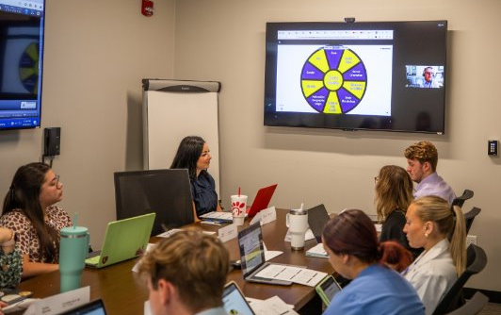
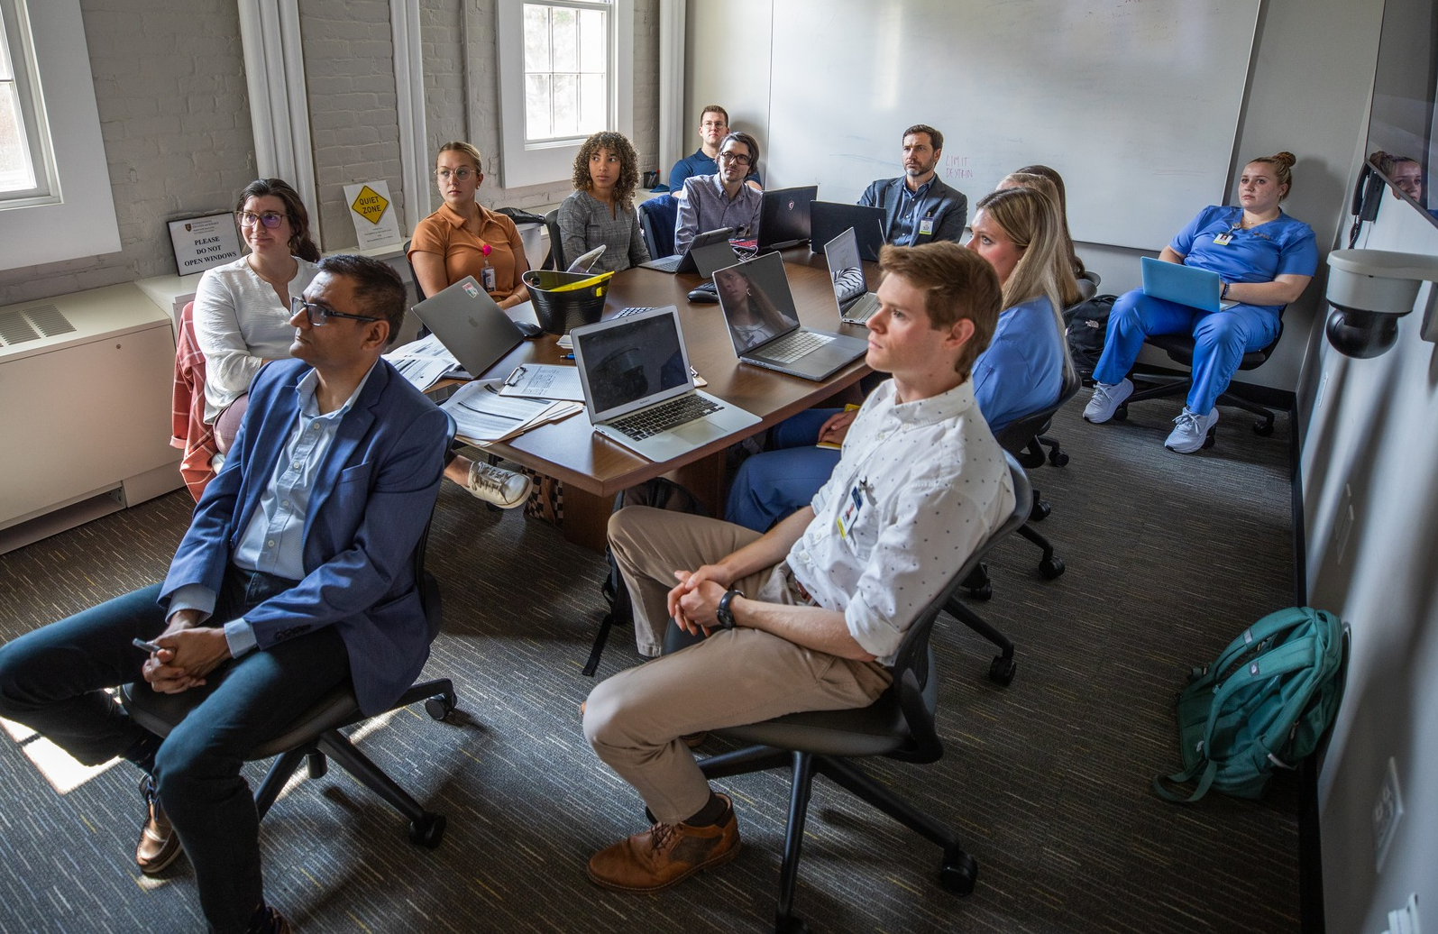
Technology
Video streaming & ARS (Engagement)
Connect small groups to a large group
Observe from afar
Engage experts from anywhere
Electronic Submission (Assessment)
Prompted discussion board post
Group submission (written / recorded)
Reflective Statement
Notes:
Brian leads report out

Slide 14
Team teaching for success

Slide 15
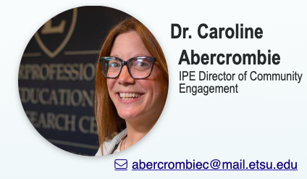
Questions / Contact Info
Dr. Amy Johnson
IPE Team Member
Senior Director of Experiential Learning
Associate Director
Center for IP Collaboration

