Slide 1
R: PasspoRt to Success
Bryan White

Slide 2
Agenda
About Me
Problem: Students face a rapidly changing future
Goal: Help Make Students More Adaptable
Solution: Use R!
Discussion

Slide 3
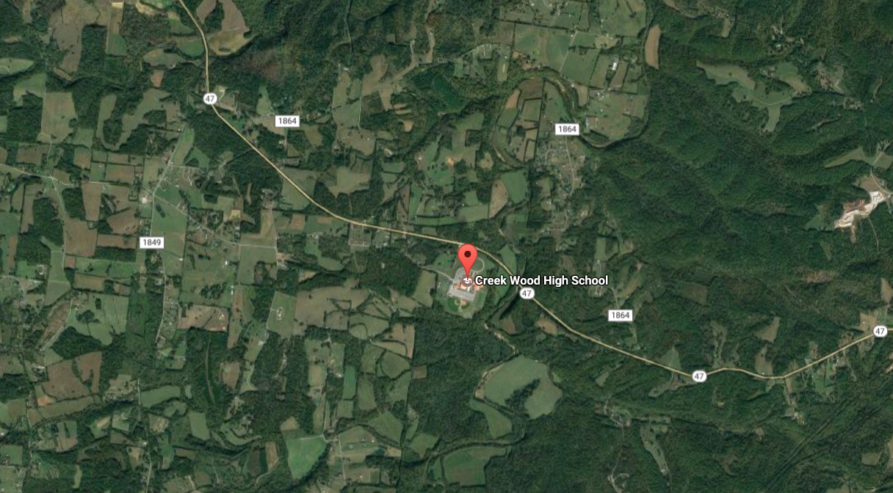
About Me

Slide 4
About Me

Slide 5
About Me

Slide 6
Problem:
Notes:
Many Student’s don’t know what they want to focus on in College, and of those that do, many change their mind

Slide 7
Goal
Enable Students to adapt to changes in their field of focus and changes in the job market.

Slide 8
Solution: R!

Slide 9
R helps transition between STEM
R is an adaptable language that has support for all STEM disciplines and many others
Diverse Open Source Libraries
Huge and Active Online User Base
Becoming the Lingua Franca of Analysis in STEM
Proficiency in R translates between disciplines and can act as a base for success in times of transition

Slide 10
R helps transition out of STEM
Outside of traditionally STEM fields, R offers great support for Business applications or everyday data wrangling
Unlike other STEM-centric software (JMP,SAS,MATLAB,Stata), R is free and has diverse uses

Slide 11
R makes students more attractive to employers
Students face a rapidly changing job market
Proficiency in R gives them a leg up in scripting code, wrangling data, and doing something useful with the data
Data savviness is becoming a vital trait as all forms of business, and many jobs face a growing mountain of information

Slide 12
Learning R early primes students for success
Like any language, R takes practice
R is easier to learn now than ever
Open source classes
Simplified syntax libraries (tidyverse)
Learning to apply R to new/different problems in HS puts students a step ahead of their peers

Slide 13
Discussion!

