Slide 1
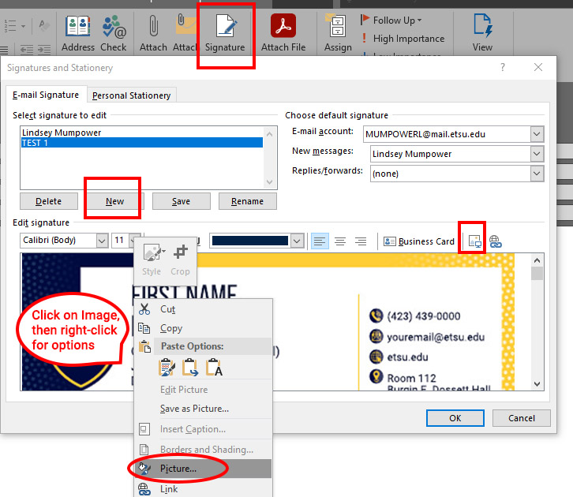
Email Signature for Accessibility
Screenshot of Outlook Signatures and Stationery
Steps:
Open a new email message in the Outlook App
Click on the “Message” tab at the top and click on “Signature”
In the pop-up window, Start a “New” signature
Click the “Insert Picture” button
Click on your image within the preview and right-click to find the “Picture…” options

Slide 2
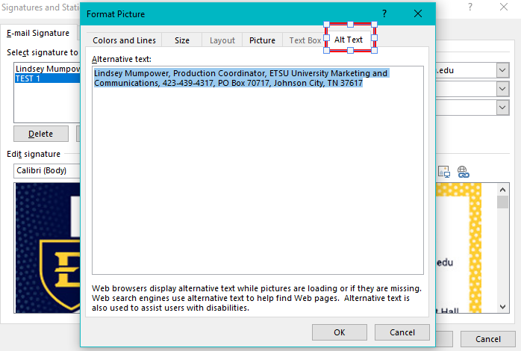
Email Signature for Accessibility: Final Step
Screenshot of Outlook Signatures and Stationery
Select the “Alt Text” tab and type in all of your signature information as alt text. Click “OK” and be sure to use your newly saved signature with alt text every time you send an email

