Slide 1

Business and Finance Campus Alert
Fraudulent emails

Slide 2

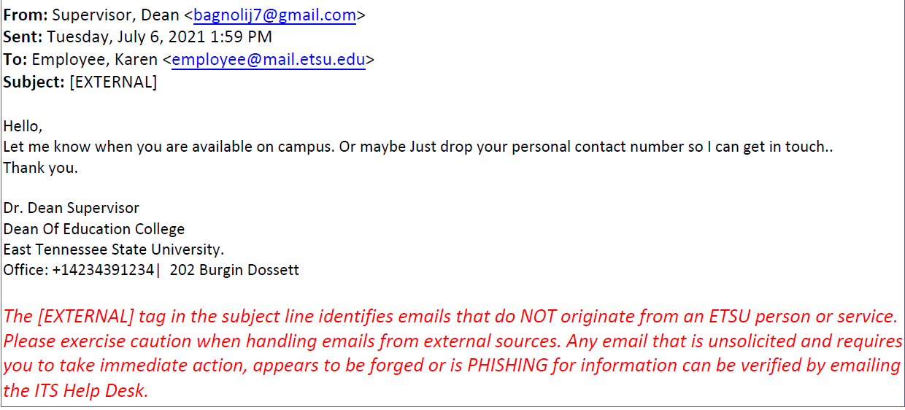
Fraud Emails Received

Slide 3

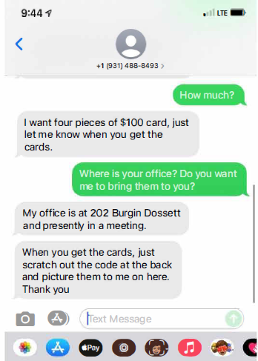
Fraud Text Received

Slide 4
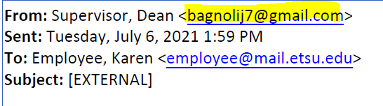
Items to look for
Look at the email address

Slide 5
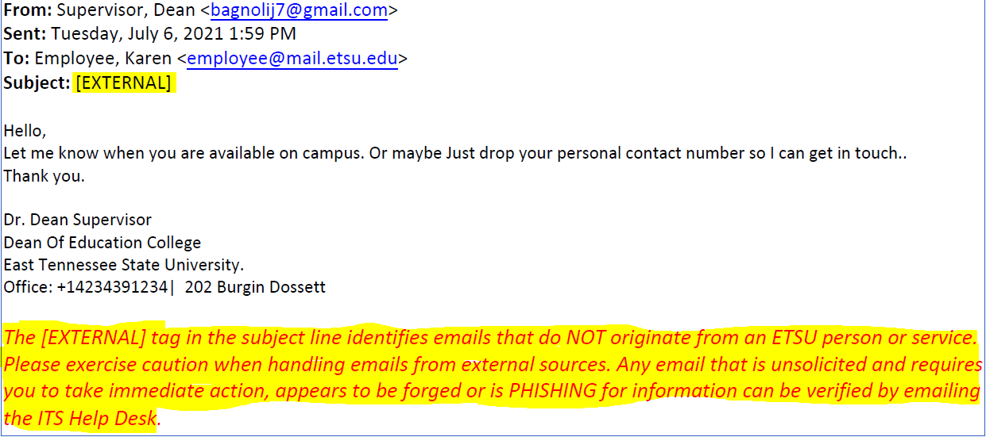
Items to look for
Look for any External tags in the email

Slide 6

Items to look for
Will ask “are you available?”
Will have an urgent request
Will be in a meeting and unable to call

Slide 7

Items to look for
Will ask for gift cards to be purchased
Often uses the term “pieces” when indicating the quantity of gift cards
Will ask that the backs of gift cards be scratched off and a picture sent

Slide 8

Remember
Gift cards are only allowed on Grants for Payments to Research Participants. (Business and Finance Policy FP-8 Sponsored Program Management)
Purchases made by employees will not be reimbursed

Slide 9

Thank you for helping keep ETSU safe!
Karen Glover, Comptroller
Email questions to: comptroller@etsu.edu

