Slide 1

Advisor Appreciation Month
March 2026

Slide 2


March is Advisor Appreciation Month!
Visit your Advisor’s office to fill out a note of appreciation and thank them for their exceptional work!

Slide 3
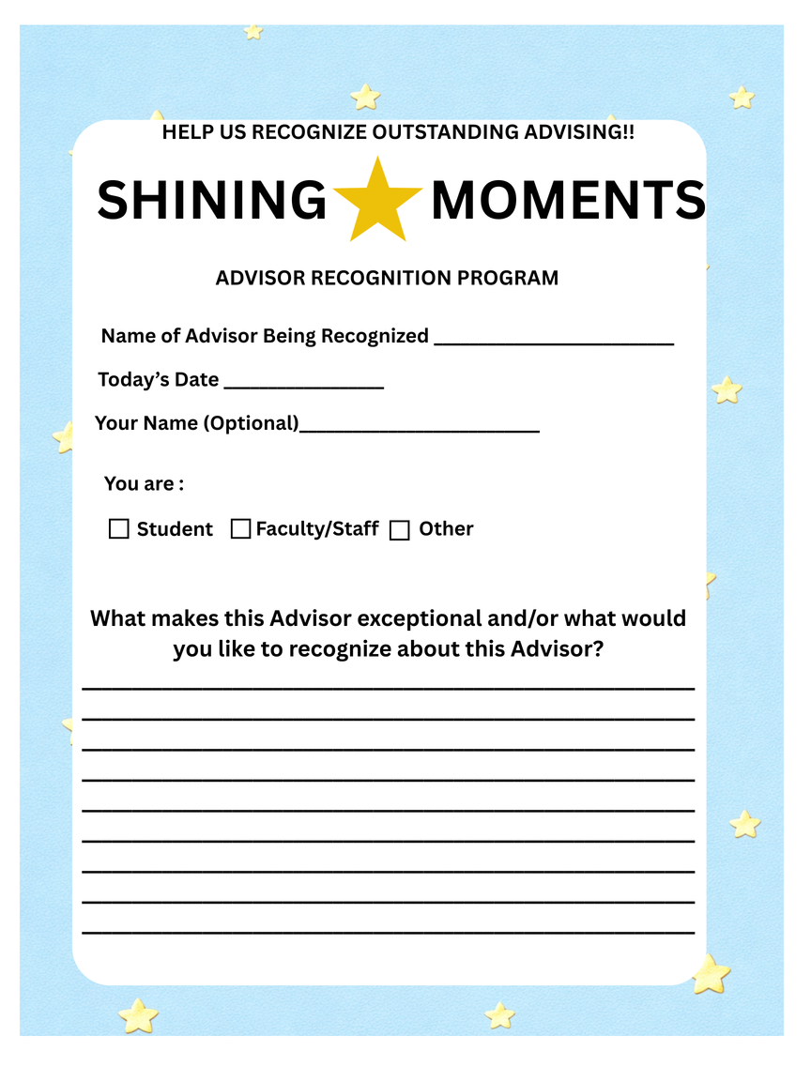
Advisor Appreciation Cards

Slide 4
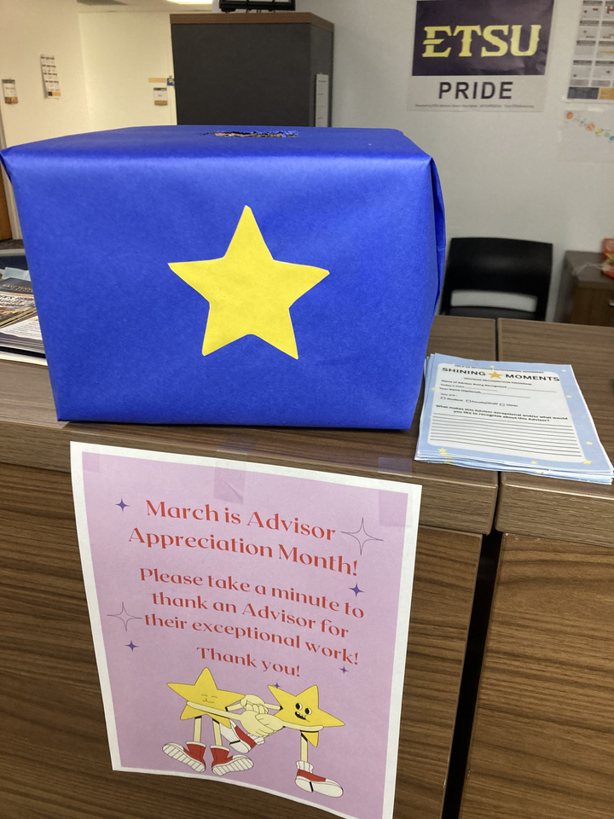
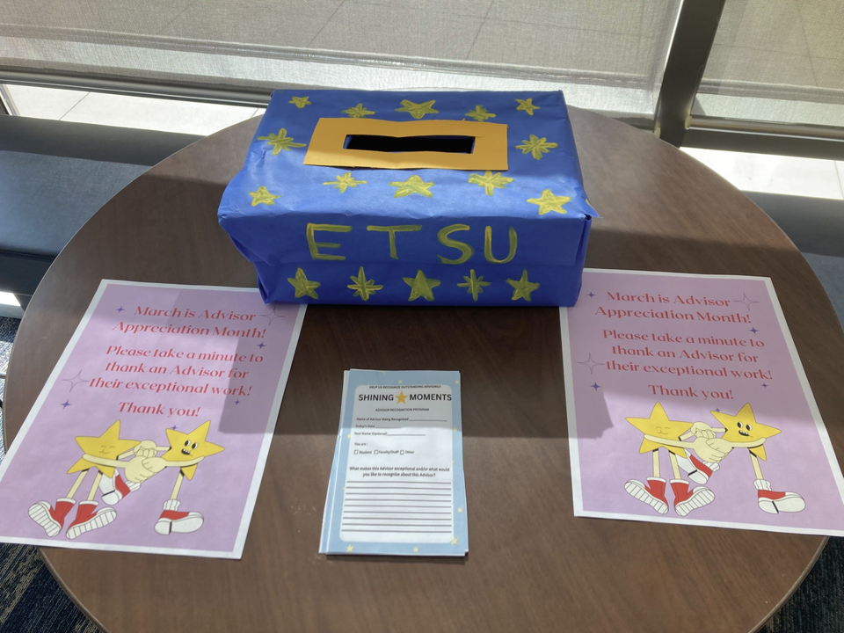
Card Stations

